Slide 1





Deep Learning for Brain Encoding and Decoding
Subba Reddy Oota¹, Jashn Arora², Manish Gupta^{2,3}, Raju S. Bapi², Mariya Toneva^{4,5}
¹Inria Bordeaux, France; ²IIIT Hyderabad, India; ³Microsoft, India; ⁴Princeton Neuroscience Institute, USA; ⁵MPI for Software Systems, Germany
subba-reddy.oota@inria.fr, jashn.arora@research.iiit.ac.in, gmanish@microsoft.com, raju.bapi@iiit.ac.in, mtoneva@mpi-sws.org

Slide 2
Agenda
Introduction to Brain encoding and decoding [30 min]
Stimulus Representations (Theory + Hands-on) [1 hour 30 min]
Coffee break [15 min]
Deep Learning for Brain Encoding (Theory + Hands-on) [1 hour 30 min]
Lunch break [1 hour 15 min]
Deep Learning for Brain Decoding (Theory + Hands-on) [1 hour 30 min]
Coffee break [15 min]
Advanced Methods [1 hour]
Summary and Future Trends [15 min]

Slide 3
Agenda
Introduction to Brain encoding and decoding [30 min]
Stimulus Representations (Theory + Hands-on) [1 hour 30 min]
Coffee break [15 min]
Deep Learning for Brain Encoding (Theory + Hands-on) [1 hour 30 min]
Classic findings & common approaches
More recent findings utilizing deep learning
Hands-on with multi-modal fMRI data [40 min]
Lunch break [1 hour 15 min]
Deep Learning for Brain Decoding (Theory + Hands-on) [1 hour 30 min]
Coffee break [15 min]
Advanced Methods [1 hour]
Summary and Future Trends [15 min]

Slide 4
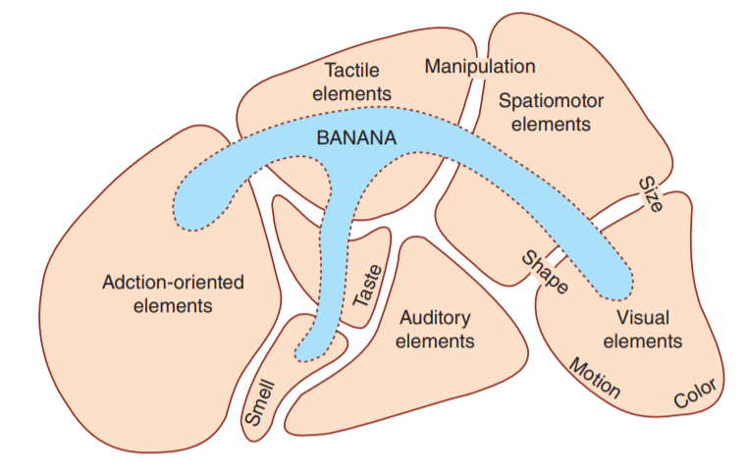
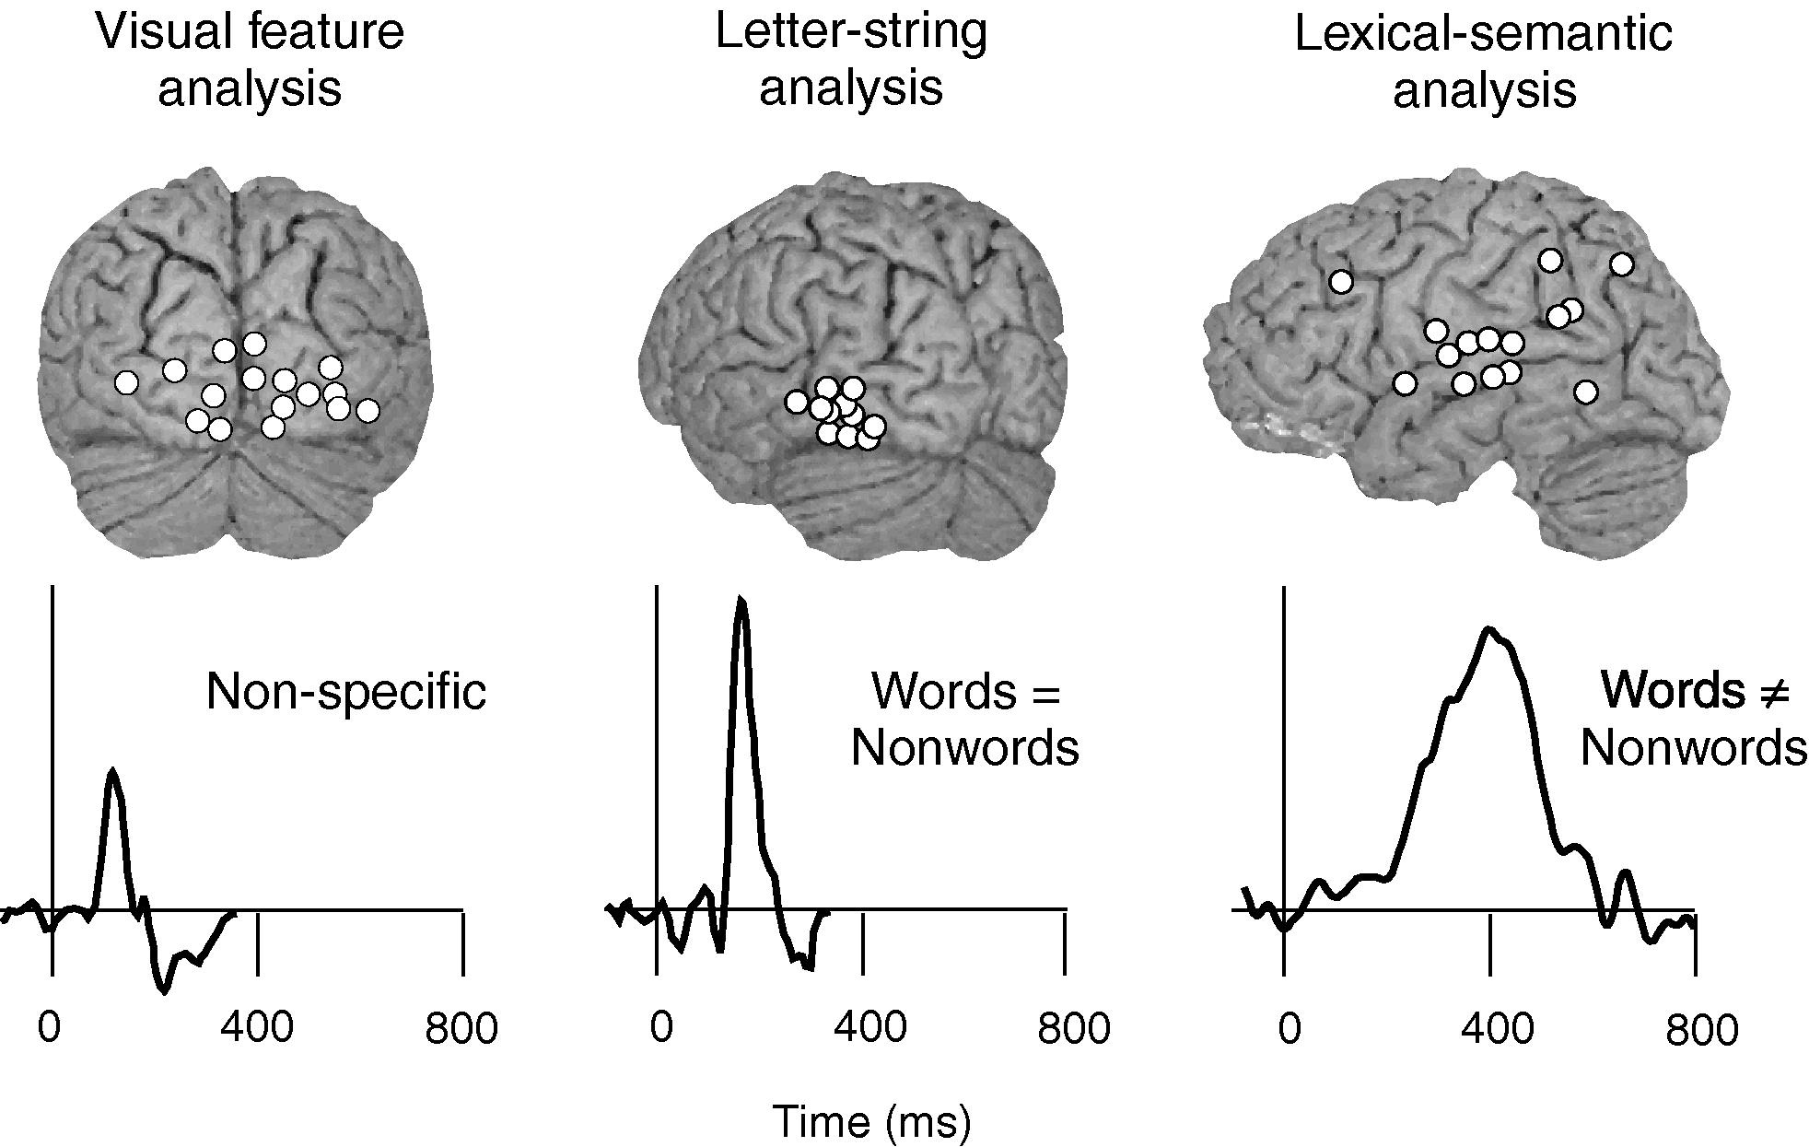
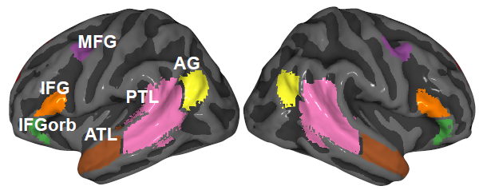
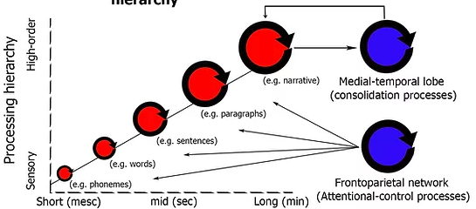
Mechanistic understanding of information processing in the brain: 4 big questions
What
When
Where
How

Slide 5


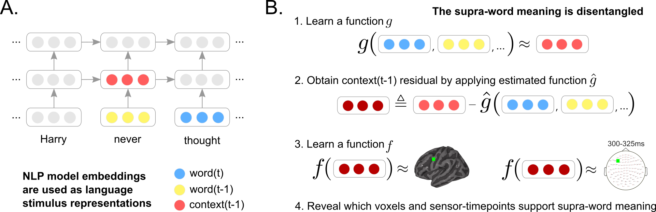


Encoding models have a causal interpretation
Reveal which brain areas are affected by stimulus properties [Weichwald et al. 2015]
y_{train}
Train:
<0,1,...0>
“The problem is when the capsule moves from an elliptical orbit to a parabolic orbit.”
^
Evaluate:
Y_{test}, Y_{test}
corr( )
stimulus properties
Part of Speech: Noun
stim. representation
<0, 1, … 0>
stimulus representation
= hypothesis for
latent brain-relevant
stimulus properties
Notes:
An encoding model predicts brain activity as a function of a representation of the stimulus that corresponds to a specific hypothesis
So for example, …
An encoding model can be used to identify the brain zones in which the activity is predicted by stimulus properties.
Under assumptions:
the stimuli are chosen by the experimenter and precede the brain measurements.
the activity predicted using the encoding model is not related to some external factors or artifacts that are correlated with the stimulus
encoding models can be causally interpreted as revealing which brain zones are affected by stimulus properties (Weichwald et al., 2015)
Note that, in this paradigm, we intervene on the stimulus and control the information presented to the participants. However, as we do not intervene directly on the brain (e.g., via transcranial magnetic stimulation) we cannot ask other, sometimes more crucial questions, such as whether the activity in a brain zone is essential for processing a stimulus.
In this part of the tutorial, we’ll go into detail about how to train and evaluate encoding models, and some recent findings that build on progress in deep learning, but first lets take a look at some classic work using encoding models

Slide 6
Classic findings using encoding models
Using representations of stimuli not from deep learning
Language:
Mitchell et al. 2008, Science
Vision:
Kay et al. 2008, Nature
Audio:
Santoro et al. 2014, PLoS Comp Bio
Notes:
Each of these classic works used stimulus representations that encoded some kind of hypothesis

Slide 7
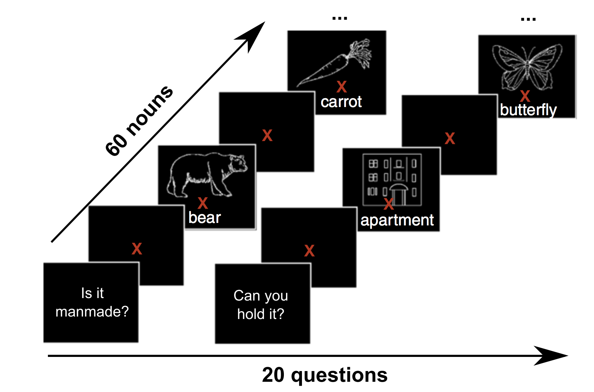
Classic encoding model finding: Language
bear
Stimuli: concrete nouns + line drawings
Stimulus representation: corpus co-occurrence counts with 25 sensory-motor verbs (e.g. see, hear, taste, smell)
Empirical evidence for distributed organization for attributes related to:
audition [Kiefer et al., 2008]
color [Simmons et al., 2007]
shape [Chao et al., 1999]
motion [Damasio et al., 1996]
olfaction and taste [Goldberg, Perfetti, et al., 2006a; Goldberg, Perfetti, et al., 2006b]
figure from Kemmerer, 2014; adapted from Thompson-Schill et al. 2006
[Barsalou, 1999; Barsalou, 2008; Pecher et al., 2005]
Mitchell, Tom M., Svetlana V. Shinkareva, Andrew Carlson, Kai-Min Chang, Vicente L. Malave, Robert A. Mason, and Marcel Adam Just. "Predicting human brain activity associated with the meanings of nouns." science 320, no. 5880 (2008): 1191-1195.

Slide 8
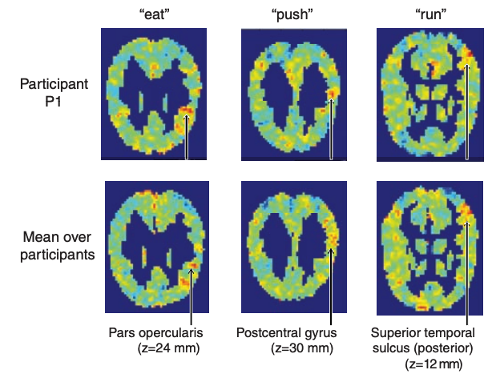
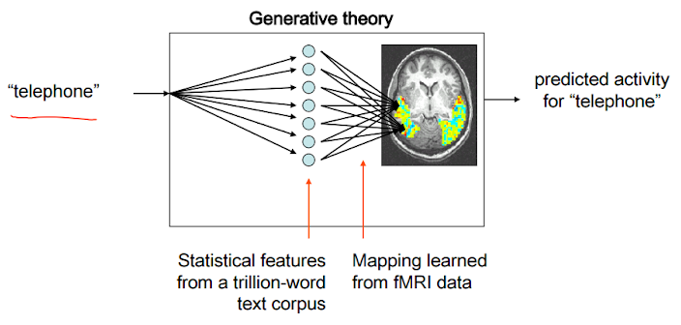
Classic encoding model finding: Language
bear
Stimuli: concrete nouns + line drawings
Stimulus representation: corpus co-occurrence counts with 25 sensory-motor verbs (e.g. see, hear, taste, smell)
Brain recording: fMRI
Correspondences
between a semantic property (“push”) and the function of the cortical regions where the fMRI recordings are well predicted
Accurately predicts fMRI recordings for a novel word
Mitchell, Tom M., Svetlana V. Shinkareva, Andrew Carlson, Kai-Min Chang, Vicente L. Malave, Robert A. Mason, and Marcel Adam Just. "Predicting human brain activity associated with the meanings of nouns." science 320, no. 5880 (2008): 1191-1195.

Slide 9
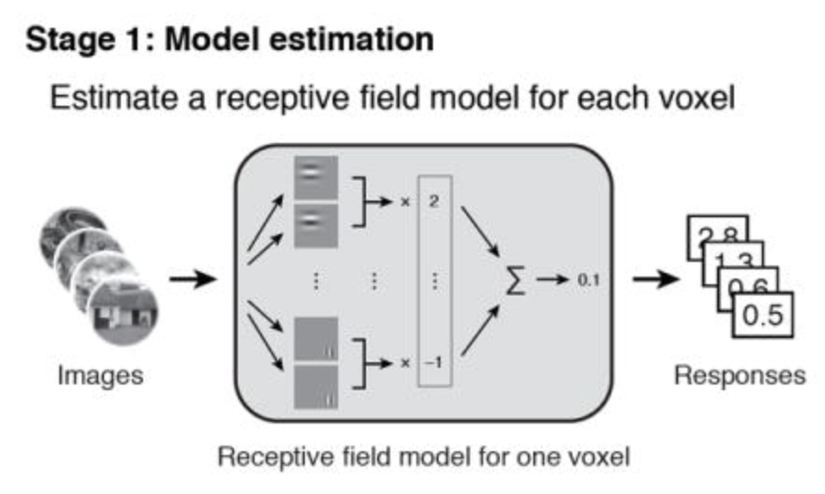
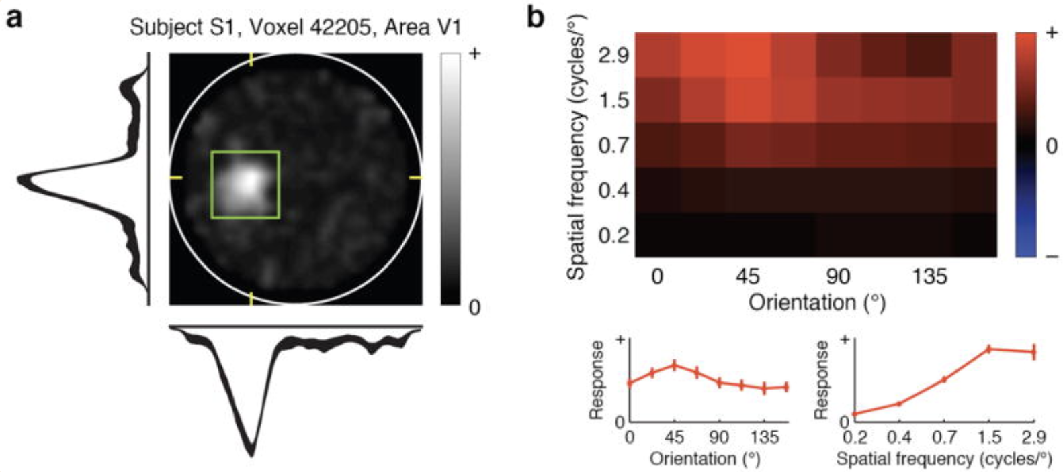
Classic encoding model finding: Vision
Stimuli: natural images
Stimulus representation: mixtures of Gabor wavelets
Brain recording & modality: fMRI, viewing
Encoding models estimated quantitative receptive fields for V1-V3 voxels
Identified which of a set of candidate natural image was viewed by a participant
Kay, Kendrick N., Thomas Naselaris, Ryan J. Prenger, and Jack L. Gallant. "Identifying natural images from human brain activity." Nature 452, no. 7185 (2008): 352-355.
Notes:
Main goal: identify what natural image is seen
In the first stage, model estimation, fMRI data were recorded from visual areas V1, V2, and V3 while each subject viewed 1,750 natural images. These data were used to estimate a quantitative receptive field model10 for each voxel (Fig. 2). The model was based on a Gabor wavelet pyramid11,13 and described tuning along the dimensions of space3,14,19, orientation1,2,20, and spatial frequency21,22
In the model each image is represented by a set of Gabor wavelets differing in size, position, orientation, spatial frequency, and phase
The receptive field model used in the present study is based on a Gabor wavelet pyramid (GWP). The GWP has long been regarded as the standard model of how primary visual cortex (V1) represents shape11–13. Under the assumption that fMRI activity reflects local pooled neural activity1,2,39–41, it is reasonable to suppose that the GWP model is appropriate for describing voxels in early visual areas. Indeed, previous results suggest that fMRI activity in V1 reflects the average activation of a population of Gabor filters28. The GWP model used in the present study describes tuning along the dimensions of space, orientation, and spatial frequency. Each of these dimensions has been previously investigated in fMRI.
Spatial envelope. The intensity of each pixel indicates the sensitivity of the receptive field (RF) to that location. The white circle delineates the bounds of the stimulus (20° × 20°) and the green square delineates the estimated RF location. Horizontal and vertical slices through the spatial envelope are shown below and to the left. These intersect the peak of the spatial envelope, as indicated by yellow tick marks. The thickness of each slice profile indicates ± 1 s.e.m. This RF is located in the left hemifield, just below the horizontal meridian. b, Orientation and spatial frequency tuning curves. The top matrix depicts the joint orientation and spatial frequency tuning of the RF, and the bottom two plots give the marginal orientation and spatial frequency tuning curves. Error bars indicate ± 1 s.e.m. This RF has broadband orientation tuning and high-pass spatial frequency tuning. For additional RF examples and population summaries of RF propertie

Slide 10
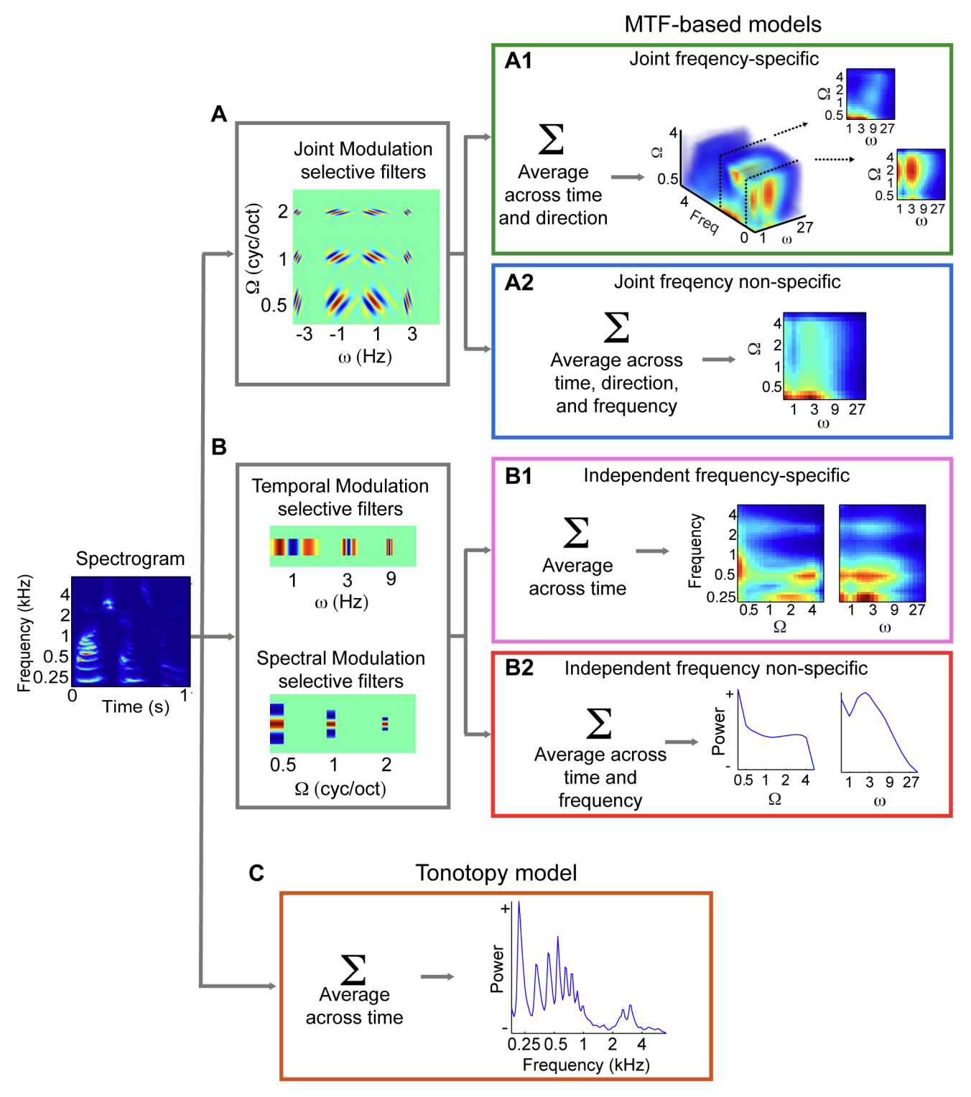
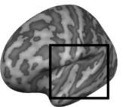
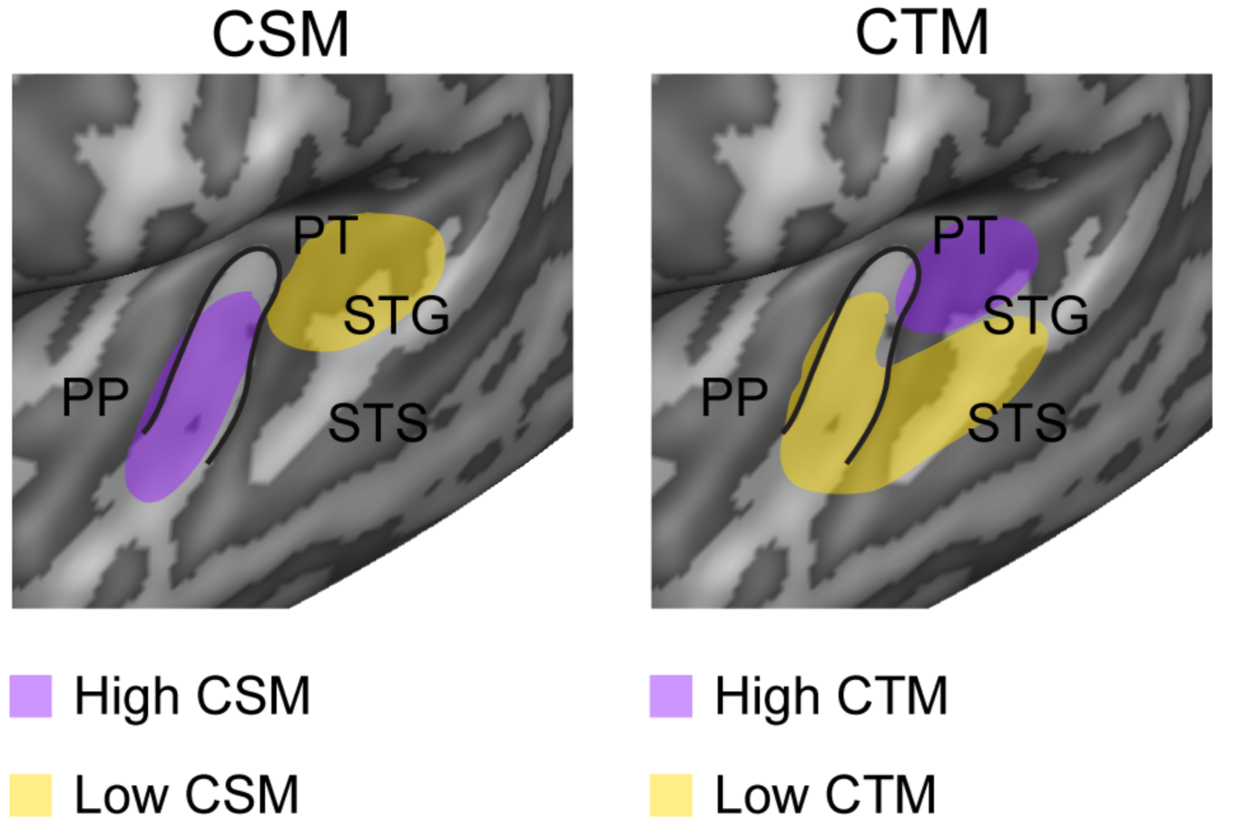
Classic encoding model finding: Audio
Stimuli: natural sounds (speech, music, nature, tools)
Stimulus representation: spectro-temporal filters that are selective for modulations along space and/or time
Brain recording & modality: fMRI, listening
spatial
temporal
posterior/dorsal auditory: coarse spectral info & high temporal precision
anterior/ventral auditory: fine-grained spectral & low temporal precision
Santoro, Roberta, Michelle Moerel, Federico De Martino, Rainer Goebel, Kamil Ugurbil, Essa Yacoub, and Elia Formisano. "Encoding of natural sounds at multiple spectral and temporal resolutions in the human auditory cortex." PLoS computational biology 10, no. 1 (2014): e1003412.
Notes:
Here, we use an fMRI “encoding” approach [24] to compare competing computational models of sound representations and select the best model as the one that can predict most accurately fMRI response patterns to natural sounds. We focus on three well-defined aspects of the representation of spectral and temporal modulations: (1) dependency, (2) frequency specificity, and (3) spatial organization.
Dependency refers to the relation between spectral and temporal processing. The spectrogram of natural sounds is characterized by concurrent spectral and temporal modulations and these sound qualities might be represented jointly or independently of each other. An independent representation implies separate processing mechanisms for spectral and temporal modulations, such that the response to one dimension is invariant to a change in the other dimension. By contrast, a joint representation relies on combined selectivity for the conjunction of spectral and temporal modulations. The joint representation can be modeled as an array of spectro-temporal filters that are selective for combinations of spectral and temporal modulations (Figure S1A), whereas the independent representation can be seen as a bank of filters that are selective for either temporal or spectral modulations (Figure S1B). In other words, the two models differ with respect to the dimensions employed by the auditory cortex to encode natural sounds (combined spectro-temporal modulations, and spectral and temporal modulations alone, respectively). Testing for the interdependency of spectral and temporal modulation processing has relevant implications, as the superiority of such a model would indicate that results obtained using sounds that only vary along one dimension (e.g. amplitude modulated tones or stationary ripples) cannot be generalized to mechanisms of representation and processing of natural sounds.
The analysis of the spectro-temporal modulation content of the sound spectrogram can be global (2D Fourier transform) or localized (e.g wavelet transform). A global representation indicates integration along the frequency axis, while in a local analysis spectral and temporal modulations are encoded in a frequency-specific fashion. Frequency specific responses are ubiquitous in the auditory cortex; yet it is not clear how this dimension is exploited for the representation of natural sounds. Understanding the nature of the modulation analysis performed by the human auditory cortex can provide insights about the functional role of this representational mechanism.
Finally, the third aspect that we consider is the existence and layout of a large-scale spatial organization of spectro-temporal modulation tuning. Topographic maps of stimulus dimensions are a well-established organizational principle of the auditory cortex [25]. In humans, the primary [26] as well as the non-primary [27] auditory cortex contain multiple topographic representations of sound frequency (tonotopic maps). Beyond tonotopy, however, the spatial organization of other sound features remains elusive [25]. Our methodological approach provides the possibility to obtain maps of multiple sound features and feature-combinations from the same set of fMRI responses and within the ecologically and behaviorally-relevant context of natural sounds processing. Here, we exploit this possibility to study the regional specificity and the spatial organization of spectro-temporal modulation tuning. Such knowledge can reveal the representational and computational basis underlying the functional specialization of auditory cortical subdivisions.
Our results show that the representation of natural sounds in the human auditory cortex relies on a frequency-specific analysis of combined spectro-temporal modulations.
Specifically, our fMRI results suggest that neuronal populations in posterior/dorsal auditory regions preferably encode coarse spectral information with high temporal precision. Vice-versa, neuronal populations in anterior/ventral auditory regions preferably encode fine-grained spectral information with low temporal precision. We propose that such a multi-resolution analysis may be crucially relevant for flexible and behaviorally-relevant sound processing and may constitute one of the computational underpinnings of functional specialization in auditory cortex.

Slide 11
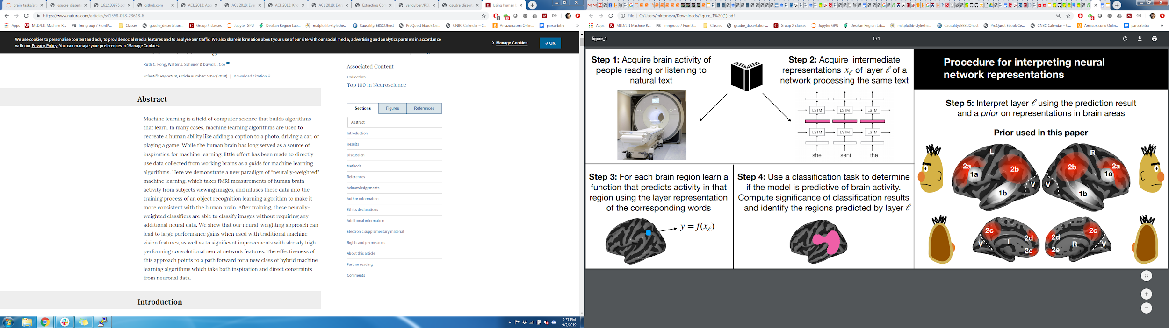



Deep learning models enable data-driven encoding models for naturalistic stimuli
more naturalistic stimuli
more stimulus properties that affect brain activity
simple stim. representations explain less variance in brain activity
<0,1,...0>
DeepMind’s New AI Taught Itself to Be the World’s Greatest Go Player
Singularity Hub
Meet GPT-3. It Has Learned to Code (and Blog and Argue)
The New York Times
Notes:
Naturalistic stimuli -> reading books, listening to stories, watching a movie
The properties of the stimulus that affect brain activity are increasing, so simple representations of the stimuli capture less variance of the brain activity
Meanwhile we have huge progress in deep learning in the last 10 years that gives us AI models that can do many tasks. Of course they are not perfect, and are sometimes flawed, but there is the question of whether we can use their internal representations of the world as rich stimulus representations that perhaps capture some of the properties that are also relevant for the processing in the brain.
Here comes to encoding model

Slide 12
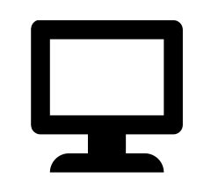

Data-driven encoding models evaluate the relationships between brains and deep learning models
Multimodal naturalistic stimulus
Deep learning system
A priori locations in DL system and brain
Data-driven encoding model
how are they related?
fMRI

Slide 13
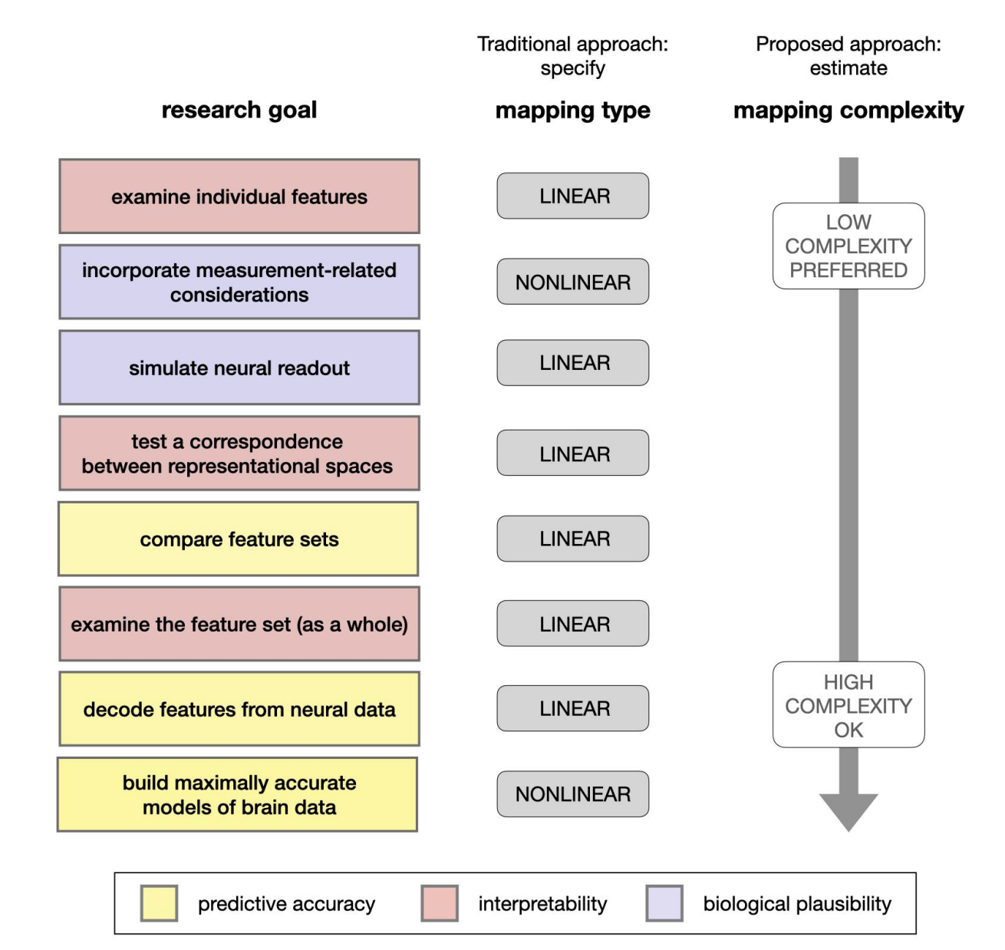
Encoding: training and evaluation
function often modeled as linear
[Mitchell et al. 2008, Nishimoto et al., 2011;
Sudre et al., 2012; Wehbe et al., 2014]
Considerations for
Linear vs non-linear
Ivanova, Anna A., Martin Schrimpf, Stefano Anzellotti, Noga Zaslavsky, Evelina Fedorenko, and Leyla Isik. "Is it that simple? Linear mapping models in cognitive neuroscience." bioRxiv (2021).
Notes:
Here, we discuss the choice of a mapping model in the context of three overarching desiderata: predictive accuracy, interpretability, and biological plausibility.
We show that, contrary to popular intuition, these desiderata do not map cleanly onto the linear/nonlinear divide; instead, each desideratum can refer to multiple research goals, each of which imposes its own constraints on the mapping model.
Moreover, we argue that, instead of categorically treating the mapping models as linear or nonlinear, we should instead aim to estimate the complexity of these models.
We show that, in many cases, complexity provides a more accurate reflection of restrictions imposed by various research goals.

Slide 14
Encoding: training and evaluation
function often modeled as linear
[Mitchell et al. 2008, Nishimoto et al., 2011;
Sudre et al., 2012; Wehbe et al., 2014]
Training: cross validation (CV), regularization parameter chosen via nested CV
Evaluation: 1) make predictions for heldout data
2) compare predictions with true brain data
3) stringent statistical testing

Slide 15
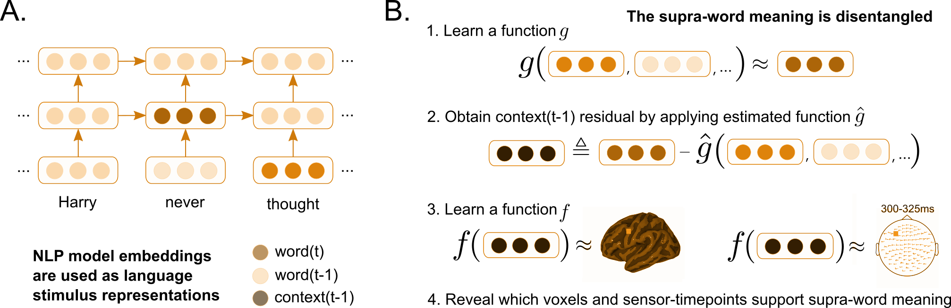
Encoding: training setup
Learn function
Method:
Split dataset into train, validation, and test
Employ cross-validation to select model parameters based on validation dataset
Reduce overfitting by using regularization
Ridge regularization
Goal: find a mapping from stimulus representation to brain data that generalizes to new brain data
Test how well predicts unseen brain recordings

Slide 16
Encoding: training independent models
Independent model per participant
P1
P2
…
PN
Independent model per voxel / sensor-timepoint
P1, v1
P1, v2
…
P1, vm

Slide 17
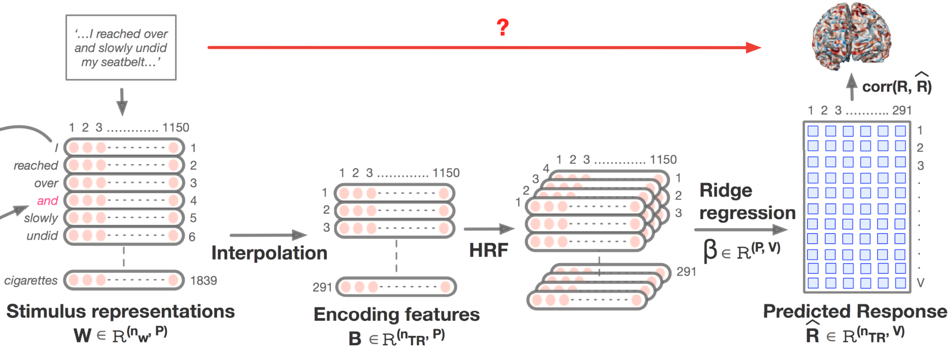
Encoding: fMRI specifics
Jain, Shailee, Vy Vo, Shivangi Mahto, Amanda LeBel, Javier S. Turek, and Alexander Huth. "Interpretable multi-timescale models for predicting fMRI responses to continuous natural speech." Advances in Neural Information Processing Systems 33 (2020): 13738-13749.

Slide 18
Encoding: evaluation setup
Predict data heldout from training by applying learned function to corresponding stimulus representations
Compare predictions of brain data to true brain data:
Evaluation metrics
Learn function
Test how well predicts unseen brain recordings

Slide 19
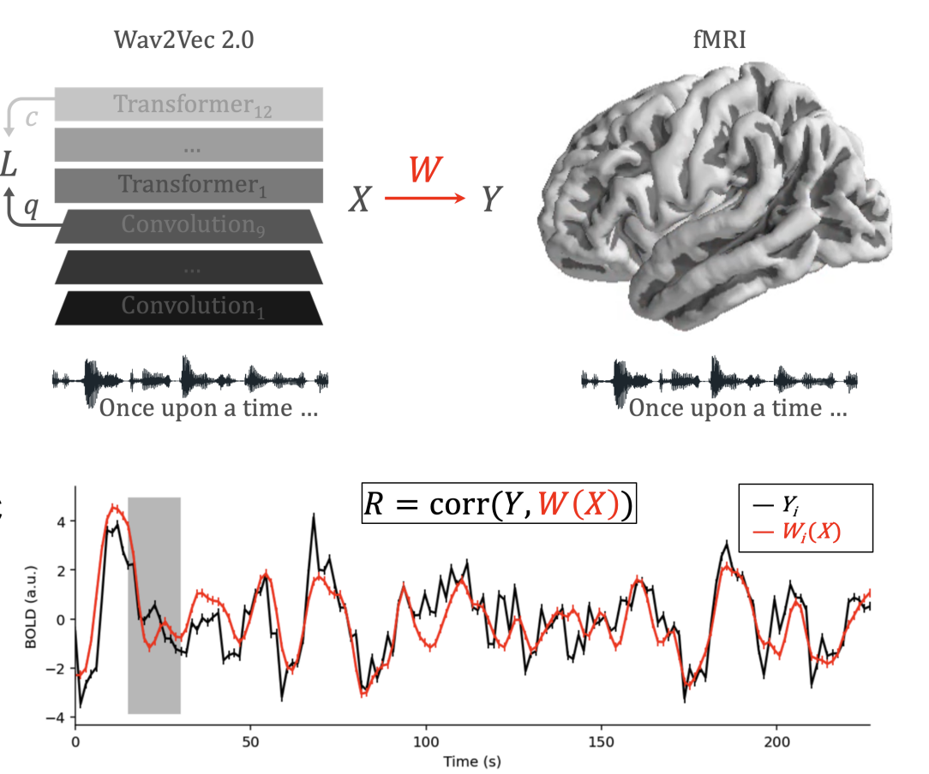
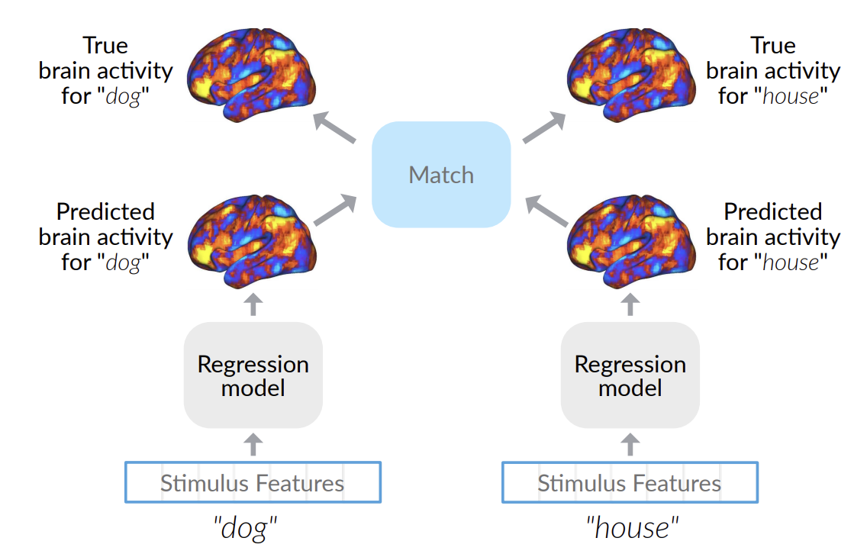
Encoding: evaluation metrics
Pearson correlation
2v2 accuracy
Millet, Juliette, Charlotte Caucheteux, Pierre Orhan, Yves Boubenec, Alexandre Gramfort, Ewan Dunbar, Christophe Pallier, and Jean-Remi King. "Toward a realistic model of speech processing in the brain with self-supervised learning." arXiv preprint arXiv:2206.01685 (2022).
Toneva, Mariya, Otilia Stretcu, Barnabás Póczos, Leila Wehbe, and Tom M. Mitchell. "Modeling task effects on meaning representation in the brain via zero-shot meg prediction." Advances in Neural Information Processing Systems 33 (2020): 5284-5295.

Slide 20
Encoding: statistical significance
Goal: determine whether the estimated similarity between the DL representations and the brain recordings is significant
Simple method that makes no assumptions about underlying data:
Permutation test
Break input-to-output correspondence by permuting output labels
Estimate similarity
Repeat 1000s times to estimate null distribution
P-value = proportion of times the similarity metric from permuted labels >= sim. metric from original labels
Specifically for fMRI:
Permute labels in blocks to preserve the autoregressive structure
Correct for multiple comparisons
FDR, FWER, etc.

Slide 21
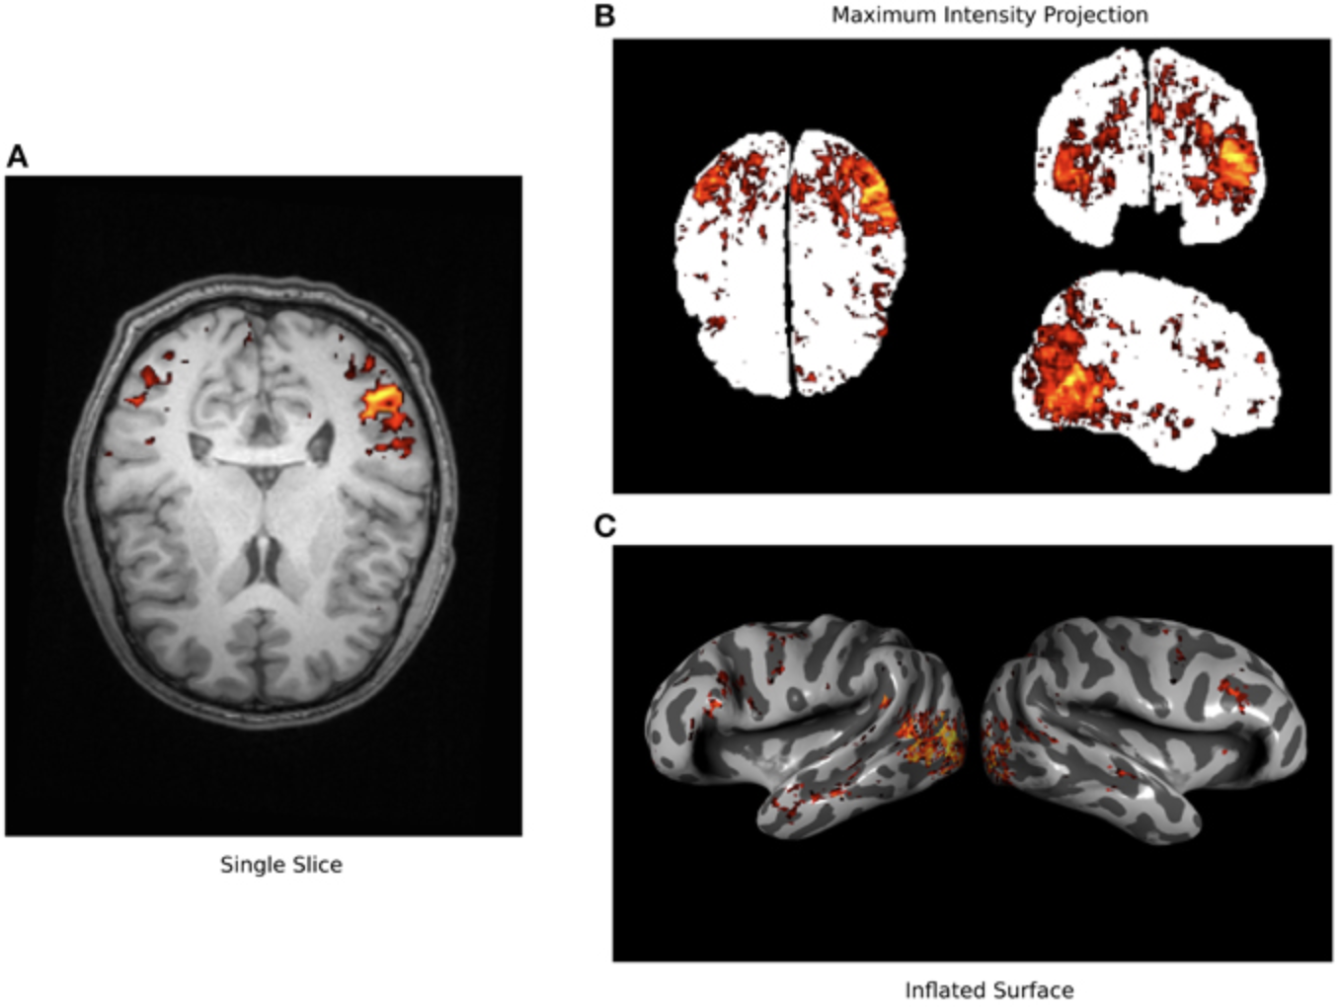
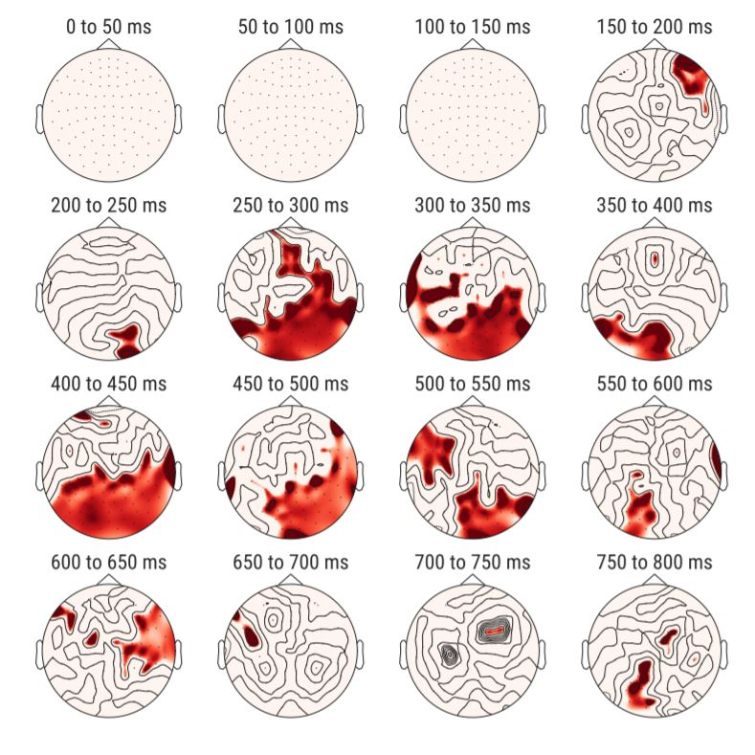
Encoding: performance visualization
fMRI
MEG/EEG
Gao, James S., Alexander G. Huth, Mark D. Lescroart, and Jack L. Gallant. "Pycortex: an interactive surface visualizer for fMRI." Frontiers in neuroinformatics (2015): 23.
Gramfort, Alexandre, Martin Luessi, Eric Larson, Denis A. Engemann, Daniel Strohmeier, Christian Brodbeck, Roman Goj et al. "MEG and EEG data analysis with MNE-Python." Frontiers in neuroscience (2013): 267.
Notes:
Three typical methods for visualizing fMRI data are used here to visualize a single data set (Huth et al., 2012). (A) A single axial slice from an anatomical image is shown overlain with functional data exceeding statistical threshold. It is difficult to recognize anatomical features in this view and much of the functional data is hidden. (B) A maximum intensity projection (i.e., a glass brain view) is shown along with all functional data that exceeds a statistical threshold. This view shows more of the functional data than can be seen in the single slice but the anatomical location of these signals is obscured. (C) An inflated cortical surface is shown with curvature highlighted in grayscale, and overlain with functional data exceeding statistical threshold. The anatomical location of the functional data is clearer than in the other views, but multiple views are required to see all of the data. None of these standard visualizations show all of the data in a succinct and interpretable way.
Pycortex improves the process of fMRI visualization in a number of ways. First, pycortex integrates a number of tools to generate high quality cortical surface reconstructions. Pycortex uses these surfaces to sample functional data using a novel projection algorithm that results in much higher resolution visualizations. Finally, we draw on the power of modern graphics cards to provide a highly interactive, accurate, and portable visualization platform that works from within any modern web browser.

Slide 22
Agenda
Introduction to Brain encoding and decoding [30 min]
Stimulus Representations (Theory + Hands-on) [1 hour 30 min]
Coffee break [15 min]
Deep Learning for Brain Encoding (Theory + Hands-on) [1 hour 30 min]
Classic findings & common approaches
More recent findings utilizing deep learning
Hands-on with multi-modal fMRI data [40 min]
Lunch break [1 hour 15 min]
Deep Learning for Brain Decoding (Theory + Hands-on) [1 hour 30 min]
Coffee break [15 min]
Advanced Methods [1 hour]
Summary and Future Trends [15 min]

Slide 23
Recent work utilizing progress in DL for encoding
Using representations of stimuli from deep learning systems
Language:
Wehbe et al. 2014; Jain and Huth, 2018; Toneva and Wehbe, 2019; Caucheteux and King, 2020/2022; Schrimpf et al. 2020/2021; Goldstein et al. 2021/2022
Vision:
Yamins et al. 2014; Cichy et al. 2016; Konkle and Alvarez, 2020/2022; Zhuang et al. 2022
Audio:
Kell et al. 2018; Vaidya, Jain, and Huth 2022; Millet et al. 2022

Slide 24
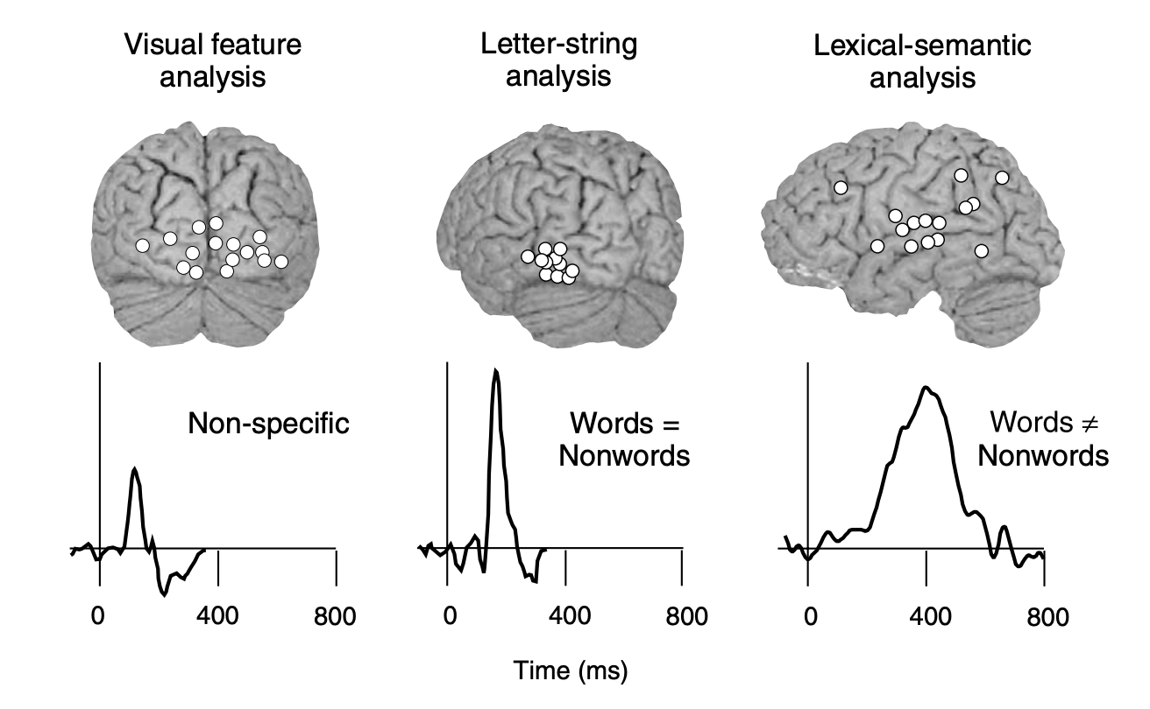
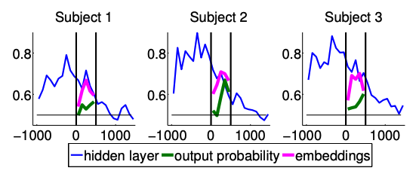
Language: work utilizing DL progress
Stimuli: one chapter of Harry Potter
Stimulus representation: derived from an NLP system (RNN) trained on Harry Potter fan fiction
Brain recording: MEG, reading
significant word-by-word alignment between MEG & representations of words and context from recurrent NLP systems
Wehbe, Leila, Ashish Vaswani, Kevin Knight, and Tom Mitchell. "Aligning context-based statistical models of language with brain activity during reading." In Proceedings of the 2014 Conference on Empirical Methods in Natural Language Processing (EMNLP), pp. 233-243. 2014.
Notes:
before a new word i is read, brain activity is well predicted by the neural network latent representation of context and the predictability decreases as the brain integrates the word and changes its own representation of context. Secondly, the neural network embedding of word i can predict the MEG activity when word i is presented to the subject, revealing that it is correlated with the brain’s own representation of word i. Moreover, we obtain that the activity is predicted in different regions of the brain with varying delay. The delay is consistent with the placement of each region on the processing pathway that starts in the visual cortex and moves to higher level regions.

Slide 25
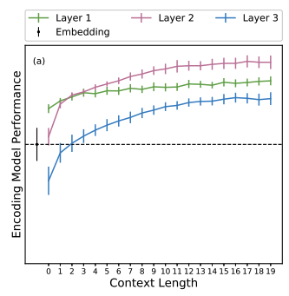
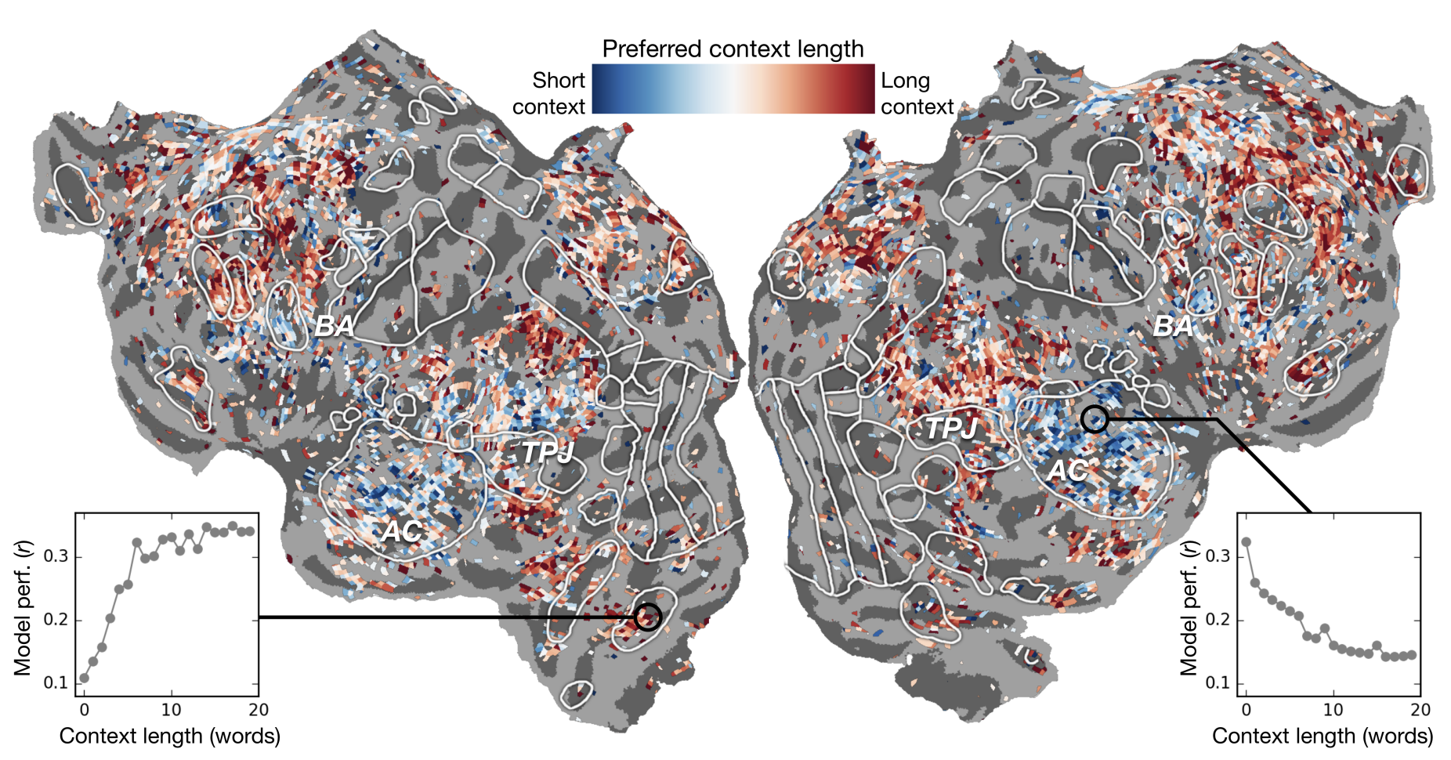
Audio: work utilizing DL progress
Stimuli: Moth Radio Hour
Stimulus representation: derived from self-supervised text language model trained to predict upcoming word in other radio stories
Brain recording & modality: fMRI, listening
alignment between fMRI & recurrent NLP representations w/ varying context;
best alignment with middle layer
Jain, Shailee, and Alexander Huth. "Incorporating context into language encoding models for fMRI." Advances in neural information processing systems 31 (2018).
Notes:
We are also able to use our models to map context sensitivity across the cortex. These results suggest that LSTM language models learn high-level representations that are related to representations in the human brain.
Context length preference across cortex. An index of context length preference is computed for each voxel in one subject (S1) and projected onto that subject’s cortical surface. Voxels shown in blue are best modeled using short context, while red voxels are best modeled with long context. Non-significantly predicted voxels (mean r < 0.11) are gray. Insets show model performance with each context length for two representative voxels, one that prefers short context (right) and one long (left). Generally, voxels in low-level language areas (AC) prefer short context, while voxels in higher-level language areas prefer long.

Slide 26
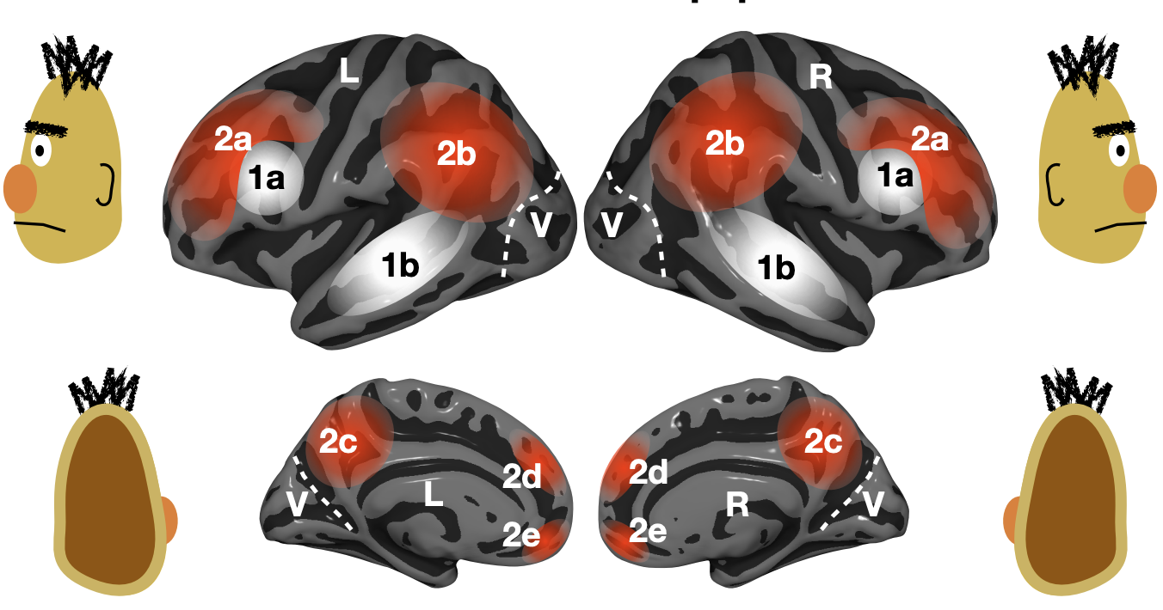
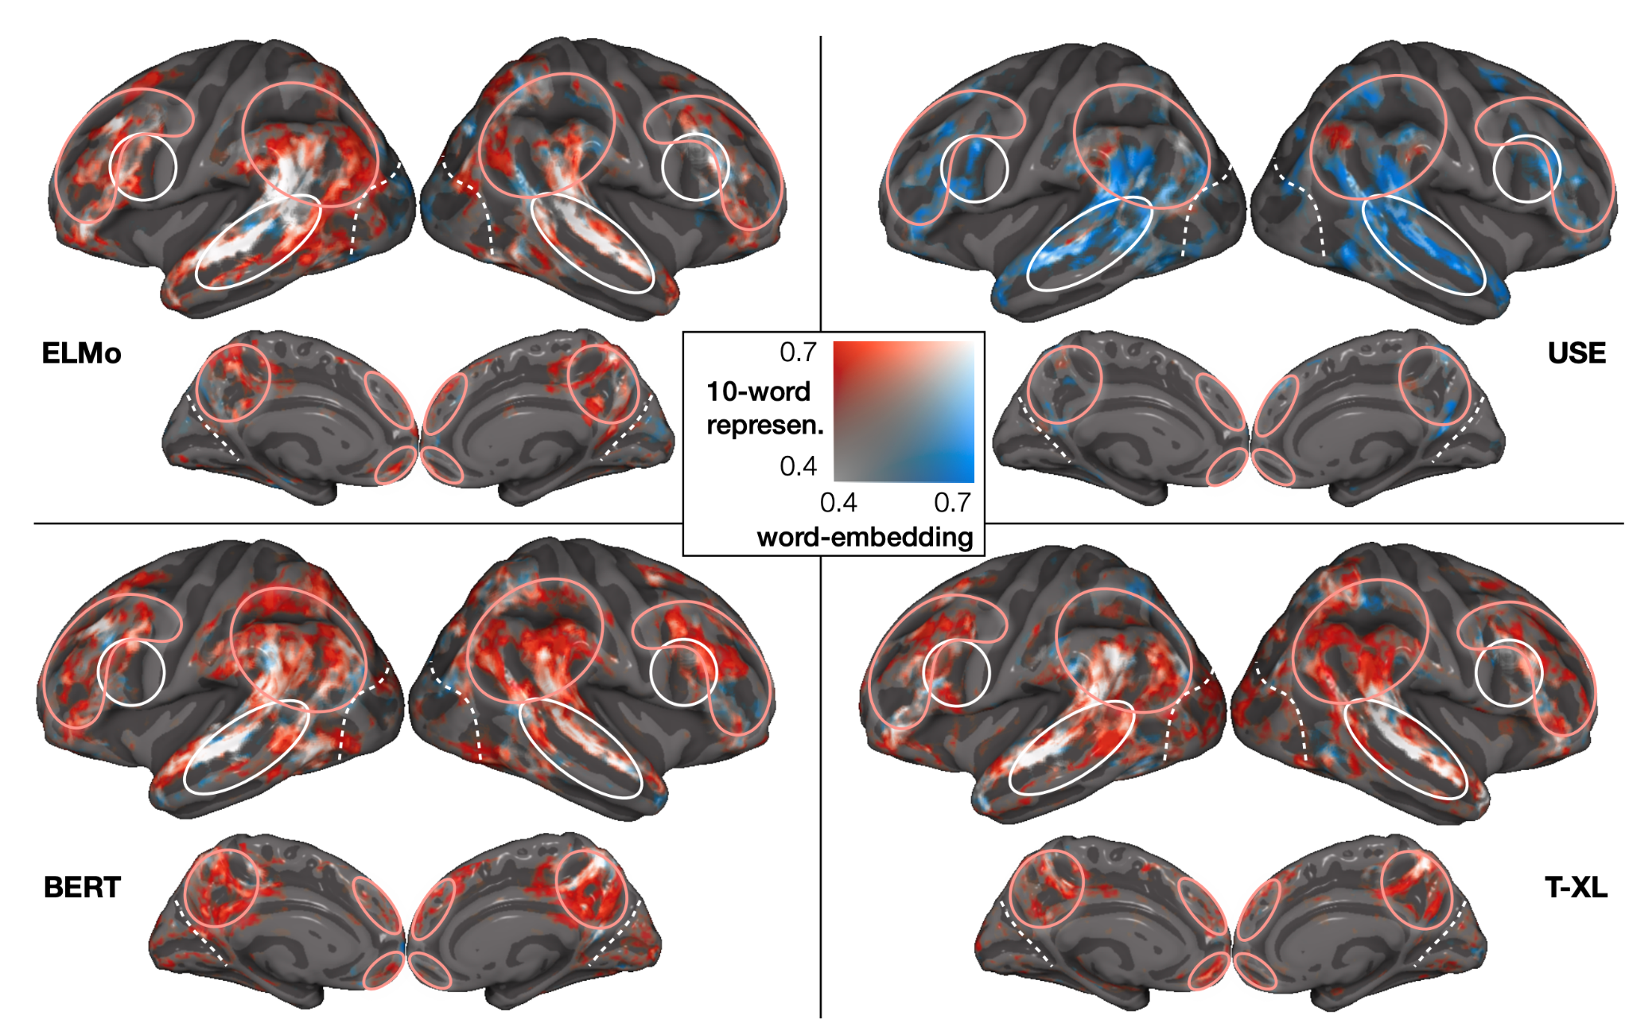
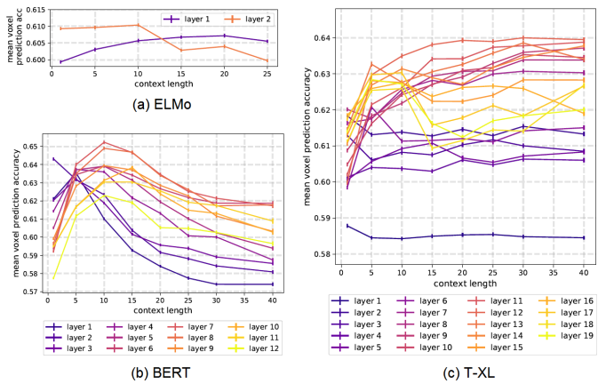
Language: work utilizing DL progress
Stimuli: one chapter of Harry Potter
Stimulus representation: derived from pretrained NLP systems
Brain recording & modality: fMRI, reading
across several types of large NLP systems, best alignment with fMRI in middle layers
Toneva, M., & Wehbe, L. (2019). Interpreting and improving natural-language processing (in machines) with natural language-processing (in the brain). Advances in Neural Information Processing Systems, 32.
Notes:
Further, in the transformer models, we find an interaction between layer depth and context length, and between layer depth and attention type. We finally hypothesize that altering BERT to better align with brain recordings would enable it to also better understand language. Probing the altered BERT using syntactic NLP tasks reveals that the model with increased brain-alignment outperforms the original model.

Slide 27
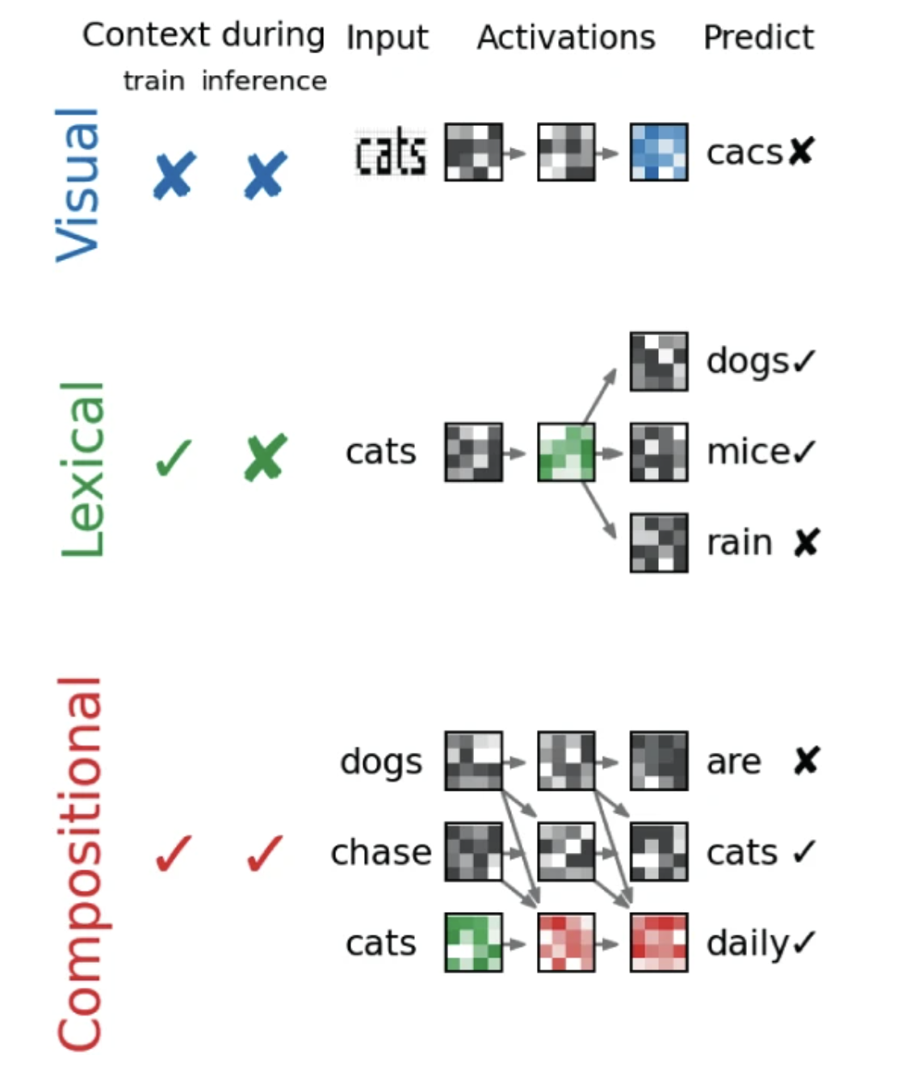
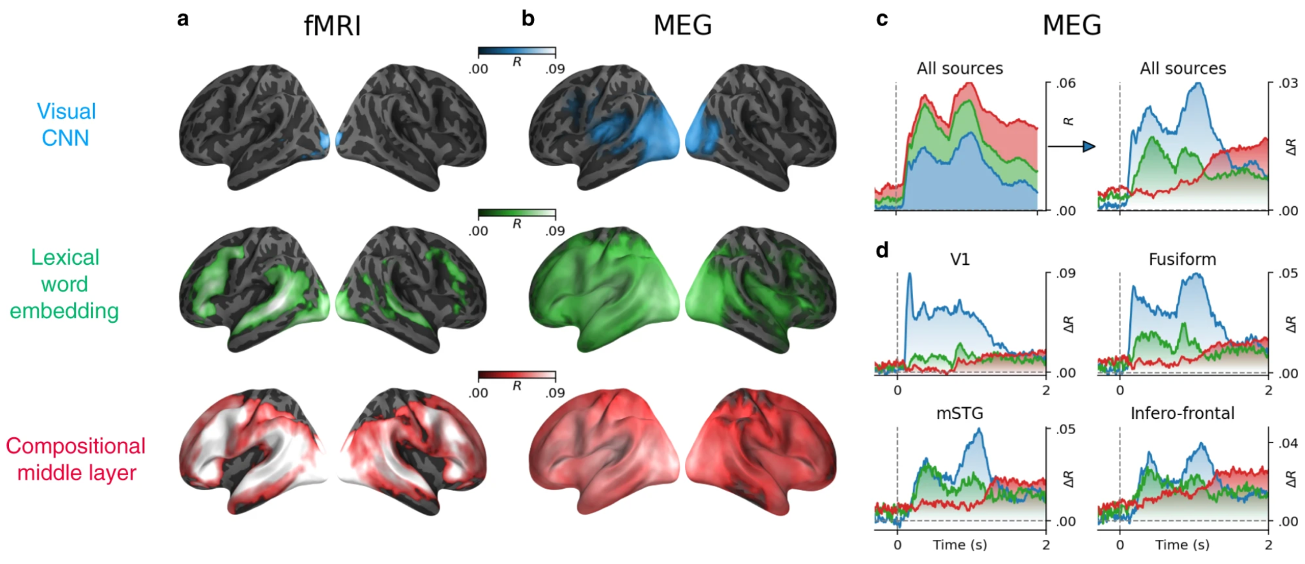
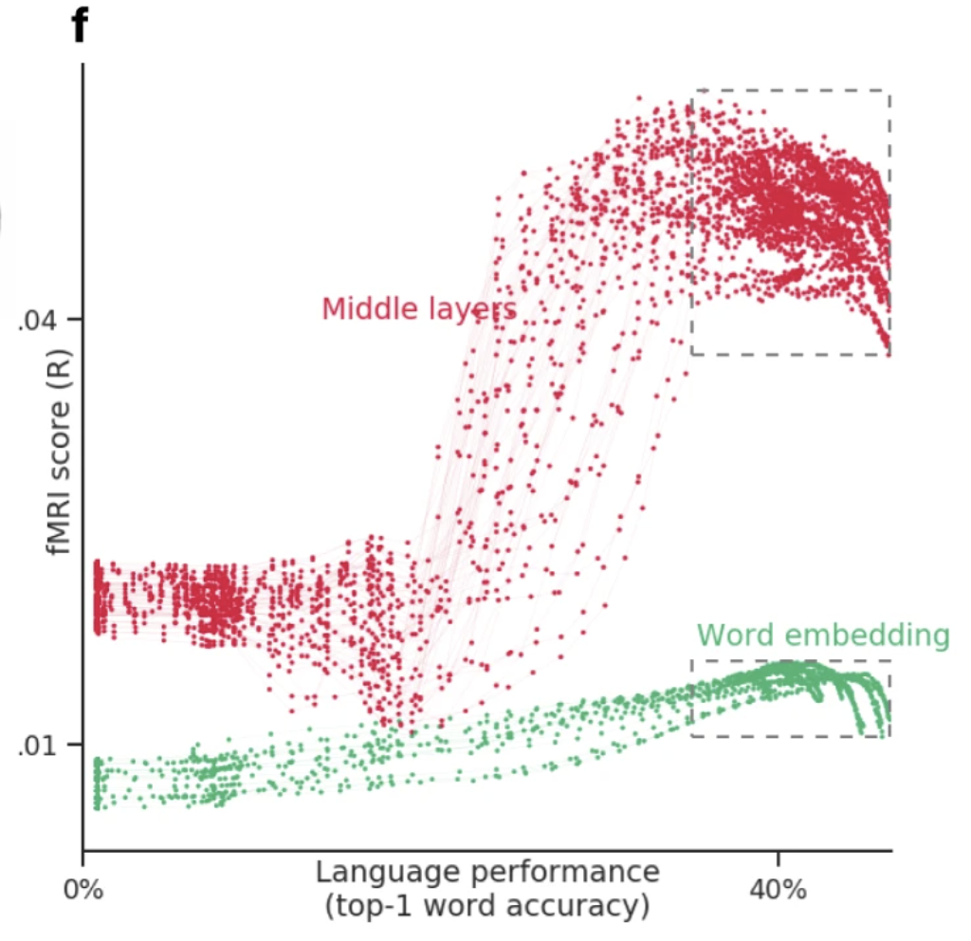
Language: work utilizing DL progress
best alignment with fMRI & MEG in middle layers
better performance at predicting next word -> better prediction of fMRI & MEg
Stimuli: sentences
Stimulus representation: derived from pretrained NLP systems
Brain recording & modality: MEG & fMRI, reading
Caucheteux, Charlotte, and Jean-Rémi King. "Brains and algorithms partially converge in natural language processing." Communications biology 5, no. 1 (2022): 1-10.
Notes:
In fMRI, the brain scores of the visual embedding peak in the early visual cortex (V1) (mean brain scores across voxels: R = 0.022 ± 0.003, p < 10−11). By contrast, the brain scores of lexical embedding peak in the left superior temporal gyrus (R = 0.052 ± 0.004, p < 10−13) as well as in the inferior temporal cortex and middle frontal gyrus (R = 0.053 ± 0.003, p < 10−15) and are significant across the entire language and reading network (Fig. 3b). Finally, the brain scores of the compositional embedding are significantly higher than those of lexical of embeddings in the superior temporal gyrus (ΔR = 0.012 ± 0.001, p < 10−16), the angular gyrus (ΔR = 0.010 ± 0.001, p < 10−16), the infero-frontal cortex (ΔR = 0.016 ± 0.001, p < 10−16) and the dorsolateral prefrontal cortex (ΔR = 0.012 ± 0.001, p < 10−13). While these effects are lateralized (left hemisphere versus right hemisphere: ΔR = 0.010 ± 0.001, p < 10−14), they are significant across a remarkably large number of bilateral areas (Fig. 3b). Lexical and compositional embeddings accurately predict brain responses in the early visual cortex. This result is not necessarily surprising: language embeddings encode features (e.g., position of words in the sentence, beginning/end of the sentence) that correlate with visual information (words are flashed at a screen, and the sentences are separated by pauses). Critically, the gain (ΔR) of these embeddings remain very small, suggesting that this effect is mainly driven by the covariance between low-level and high-level representations of words.
To characterize the dynamics of these brain representations, we perform the same analysis using source-localized MEG recordings. The resulting brain scores are consistent with—although less spatially precise than—the above fMRI results (Fig. 3c, average brain score between 0 and 2 s). For clarity, Fig. 3d and Supplementary Movie 2 plot the gain in MEG scores: i.e., the difference of prediction performance between i) word and visual embeddings (green) and ii) the difference between compositional and word embedding (red). The brain scores of the visual embedding peak around 100 ms in V1 (R = 0.008 ± 0.002, p < 10−3), and rapidly propagate to higher-level areas (Fig. 3d and Supplementary Movie 2). The gain achieved by the word embedding can be observed in the left posterior fusiform gyrus around 200 ms and peaks around 400 ms and in the left temporal and frontal cortices. Finally, the gain achieved by the compositional embedding is observed in a large number of bilateral brain regions, and peaks around 1 s after word onset (Fig. 3c, d).
After that period, brain areas outside the language network, such as area V1, appear to be better predicted by word and compositional embeddings than by visual ones (e.g., between visual and word in V1: ΔR = 0.016 ± 0.002, p < 10−10). These effects could thus reflect feedback activity45 and explain why the corresponding fMRI responses are better accounted for by word and compositional embeddings than by visual ones.
Second, brain scores strongly correlate with language accuracy in both MEG (R = 0.77 Pearson’s correlation on average ± 0.01 across subjects) and fMRI (R = 0.57 ± 0.02, Fig. 4b, c). The correlation is highest for middle (fMRI: R = 0.81 ± 0.02; MEG: R = 0.86 ± 0.01) than input (fMRI: R = 0.39 ± 0.03; MEG: R = 0.73 ± 0.02) and output layers (fMRI: R = 0.63 ± 0.03; MEG:R = 0.78 ± 0.02). Beta

Slide 28
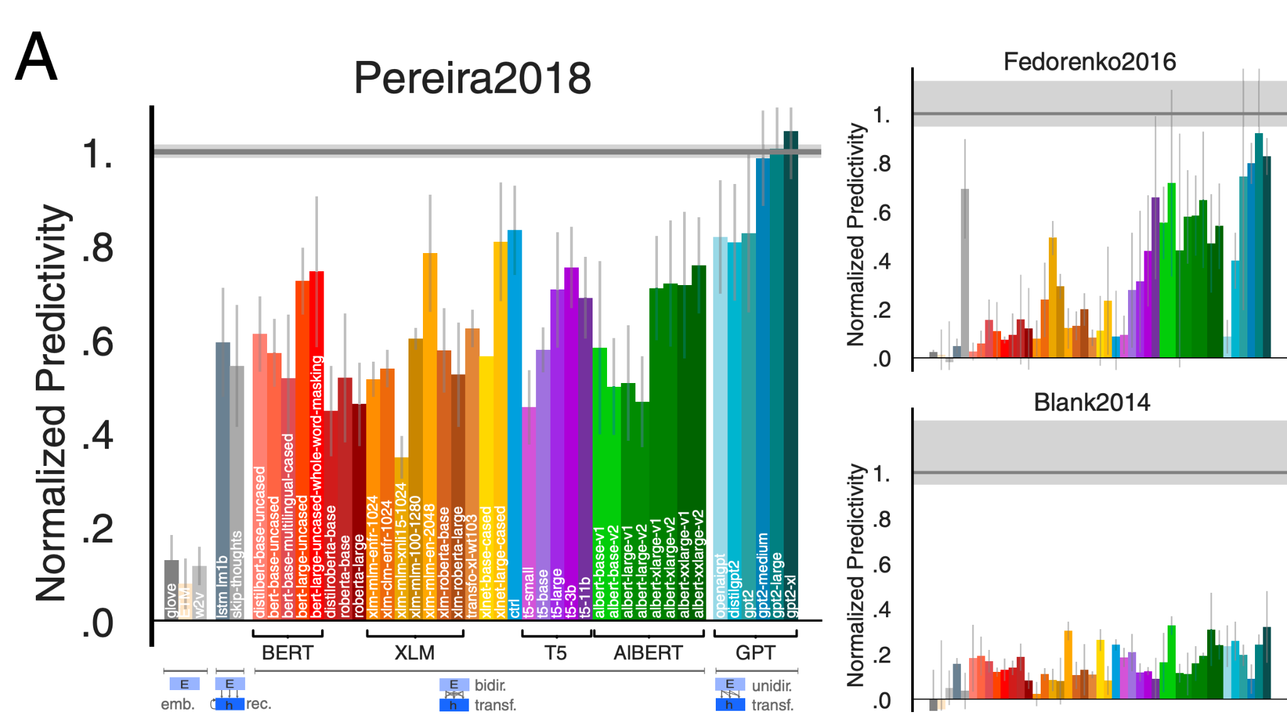
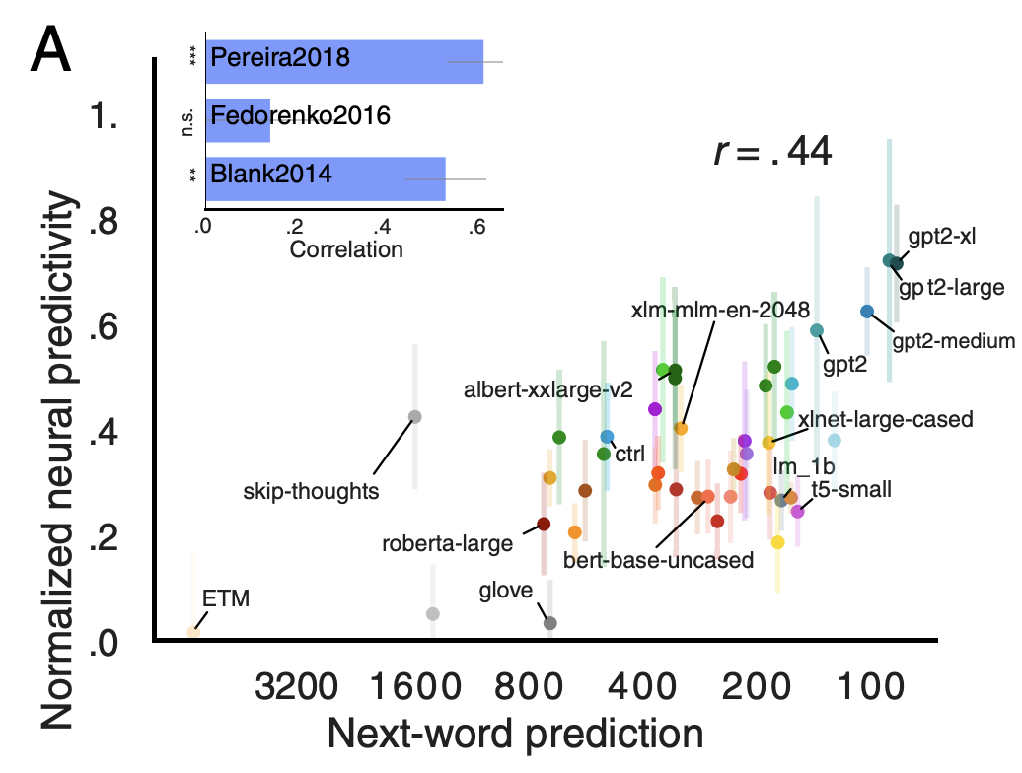
Language: work utilizing DL progress
Stimuli: sentences, passages, short story
Stimulus representation: derived from pretrained NLP systems
Brain recording & modality: fMRI & ECoG, reading & listening
some NLP systems can predict fMRI and ECoG up to 100% of estimated noise ceiling
Schrimpf, Martin, Idan Asher Blank, Greta Tuckute, Carina Kauf, Eghbal A. Hosseini, Nancy Kanwisher, Joshua B. Tenenbaum, and Evelina Fedorenko. "The neural architecture of language: Integrative modeling converges on predictive processing." Proceedings of the National Academy of Sciences 118, no. 45 (2021): e2105646118.
Notes:
The datasets varied in the imagingmodality (fMRI/ECoG), the nature of the materials (uncon-nected sentences/passages/stories), the grain of linguistic unitsto which responses were recorded (sentences/words/2-s-longstory fragments), and presentation modality (reading/listening).
We find that the most powerful models predict neural and behavioral responses across different datasets up to noise levels. Models that perform better at predicting the next word in a sequence also better predict brain measurements
Next-word-prediction task performance is predictive of reading times
Brain scores correlate with behavioral scores

Slide 29
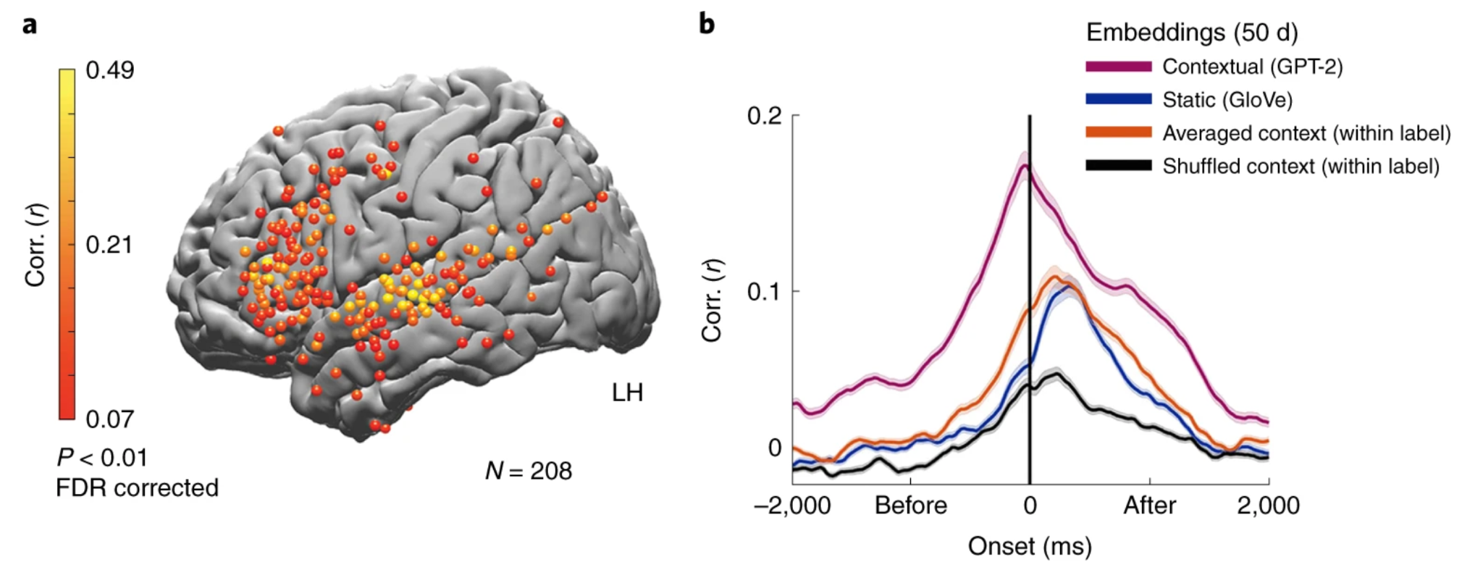
Language: work utilizing DL progress
Stimuli: story
Stimulus representation: derived from pretrained NLP systems
Brain recording & modality: ECoG, listening
NLP word representations predict ECoG recordings for upcoming words
Goldstein, Ariel, Zaid Zada, Eliav Buchnik, Mariano Schain, Amy Price, Bobbi Aubrey, Samuel A. Nastase et al. "Shared computational principles for language processing in humans and deep language models." Nature neuroscience 25, no. 3 (2022): 369-380.
Notes:
DLMs share three fundamental computational principles as they process the same natural narrative: (1) both are engaged in continuous next-word prediction before word onset; (2) both match their pre-onset predictions to the incoming word to calculate post-onset surprise; (3) both rely on contextual embeddings to represent words in natural contexts.
Peak correlation between predicted and actual word responses for the contextual (GPT-2) embeddings. Using contextual embeddings significantly improved the encoding model’s ability to predict the neural signals for unseen words across many electrodes. b, Encoding model performance for contextual embeddings (GPT-2) aggregated across 160 electrodes with significant encoding for GloVe (Fig. 3c): contextual embeddings (purple), static embeddings (GloVe, blue), contextual embeddings averaged across all occurrences of a given word (orange), contextual embeddings shuffled across context-specific occurrence of a given word (black).
Indeed, removing context from the contextual embedding by averaging the vector for each unique word effectively reduced the encoding model’s performance to that of the static GloVe embeddings (Fig. 6b).
Finally, we examined how the specificity of the contextual information in the contextual embeddings improved the ability to model the neural responses to each word. To that end, we scrambled the embeddings across different occurrences of the same word in the story (for example, switched the embedding of the word ‘monkey’ in sentence 5 with the embedding for the word ‘monkey’ in sentence 50). This manipulation tests whether contextual embeddings are necessary for modeling neural activity for a specific sequence of words. Scrambling the same word occurrences across contexts substantially reduced the encoding model performance (Fig. 6b), pointing to the contextual dependency represented in the neural signals. Taken together, these results suggest that contextual embeddings provide us with a new way to model the context-dependent neural representations of words in natural contexts.
Finally, averaging contextual embeddings associated with a given word removed the contextual information and effectively changed GPT-2’s contextual embedding back into static word embeddings (Fig. 6b). Taken together, these results suggest that the brain is coding for the semantic relationship among words contained in static embeddings while also being tuned to the unique contextual relationship between the specific word and the preceding words in the sequence53.

Slide 30
Recent work utilizing progress in DL for encoding
Using representations of stimuli from deep learning systems
Data-driven
Language:
Wehbe et al. 2014; Jain and Huth, 2018; Toneva and Wehbe, 2019; Caucheteux and King, 2020/2022; Schrimpf et al. 2020/2021; Goldstein et al. 2021/2022
Vision:
Yamins et al. 2014; Cichy et al. 2016; Konkle and Alvarez, 2020/2022; Zhuang et al. 2022
Audio:
Kell et al. 2018; Vaidya, Jain, and Huth 2022; Millet et al. 2022

Slide 31
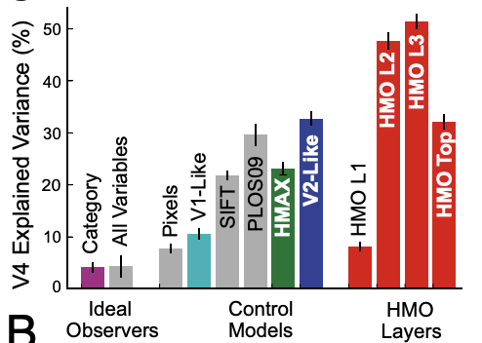
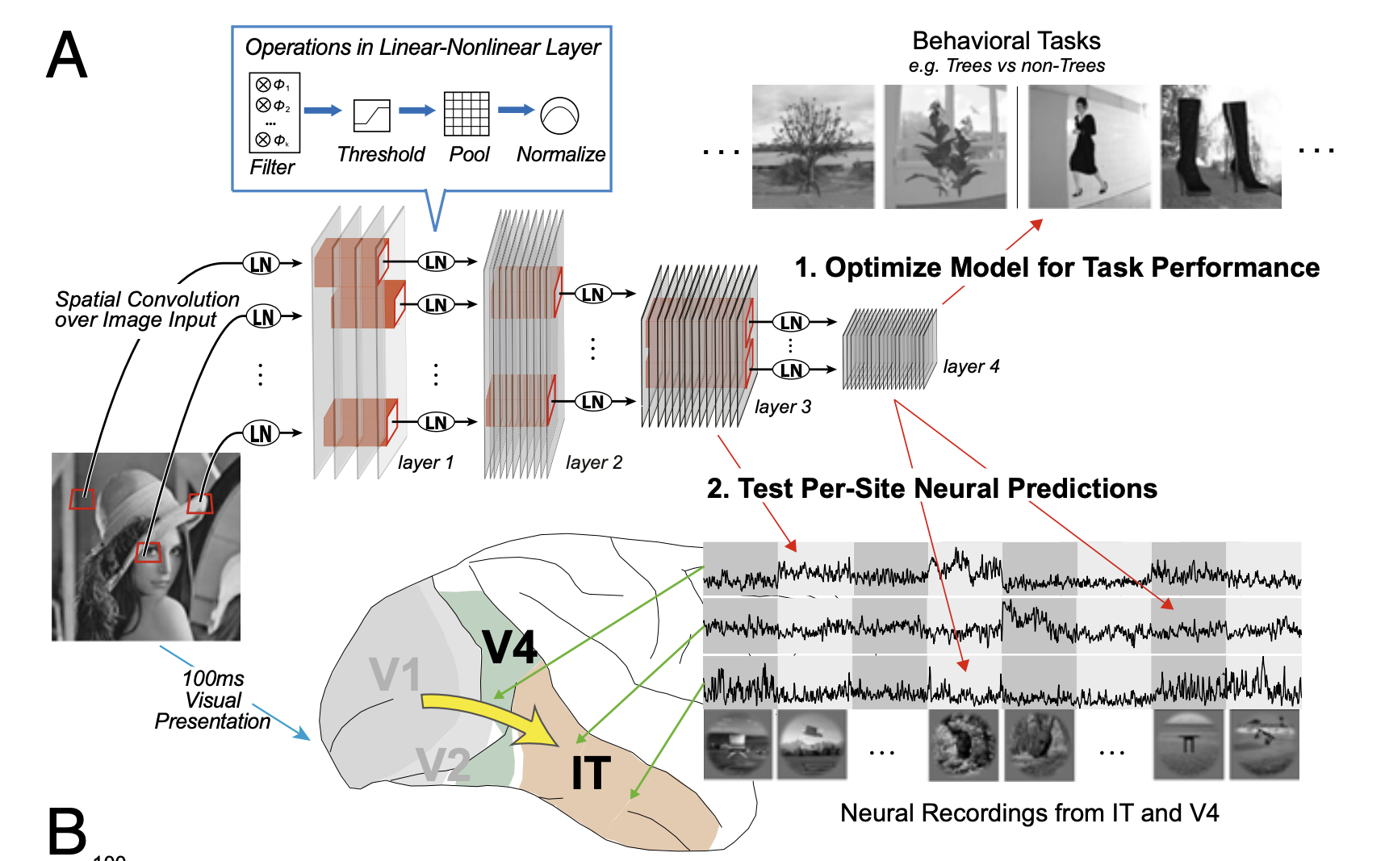
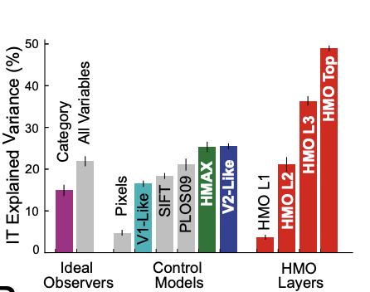
Vision: work utilizing DL progress
Stimuli: images of natural objects
Stimulus representation: layers in pretrained CNNs
Brain recording & modality: multiarray recordings in rhesus macaques, vision
Highest layer in CNN model most predictive of IT; intermediate layers most predictive of V4
Yamins, Daniel LK, Ha Hong, Charles F. Cadieu, Ethan A. Solomon, Darren Seibert, and James J. DiCarlo. "Performance-optimized hierarchical models predict neural responses in higher visual cortex." Proceedings of the national academy of sciences 111, no. 23 (2014): 8619-8624.
Notes:
IT = inferior temporal = highest ventral cortical area
The ventral stream is thought to function as a series of hierarchical processing stages (5–7) that encode image content (e.g., object identity and category) increasingly explicitly in successive cortical areas (1, 8, 9). For example, neurons in the lowest area, V1, are well described by Gabor-like edge detectors that extract rough object outlines (10), although the V1 population does not show robust tolerance to complex image transformations (9). Conversely, rapidly evoked population activity in top-level inferior temporal (IT) cortex can directly support realtime, invariant object categorization over a wide range of tasks (11, 12). Midlevel ventral areas—such as V4, the dominant cortical input to IT—exhibit intermediate levels of object selectivity and variation tolerance (12–14).
The HMO procedure embodies a conceptually simple hypothesis for how high-performing combinations of functionally specialized hierarchical architectures can be efficiently discovered and hierarchically combined, without needing to prespecify the subtasks ahead of time. Algorithmically, HMO is analogous to an adaptive boosting procedure (33) interleaved with hyperparameter optimization
Via this pretraining, the HMO procedure identified a four-layer CNN with 1,250 top-level outputs (Figs. S2B and S5), which we will refer to as the HMO model.
within a class of biologically plausible hierarchical neural network models, there is a strong correlation between a model’s categorization performance and its ability to predict individual IT neural unit response data.
To pursue this idea, we then identified a high-performing neural network that matches human performance on a range of recognition tasks. Critically, even though we did not constrain this model to match neural data, its top output layer turns out to be highly predictive of IT spiking responses to complex naturalistic images at both the single site and population levels. Moreover, the model’s intermediate layers are highly predictive of neural responses in the V4 cortex, a midlevel visual area that provides the dominant cortical input to IT. These results show that performance optimization—applied in a biologically appropriate model class— can be used to build quantitative predictive models of neural processing.

Slide 32
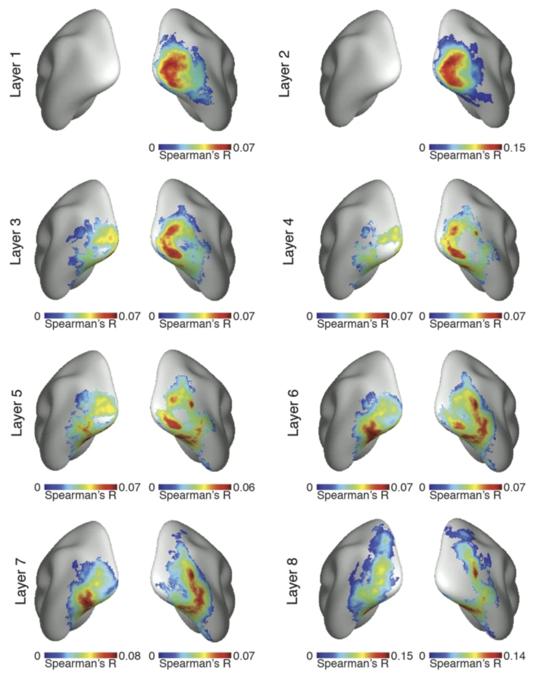
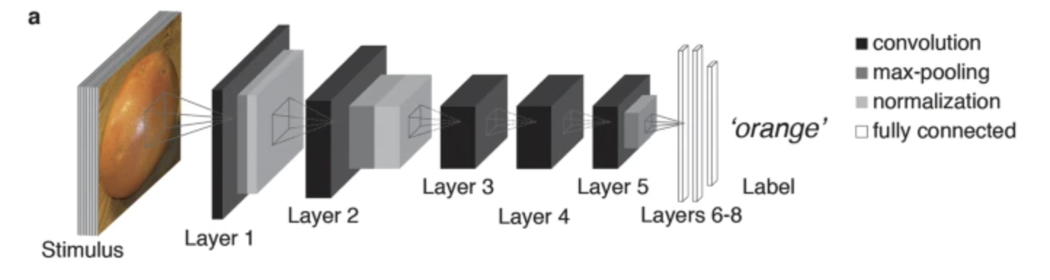
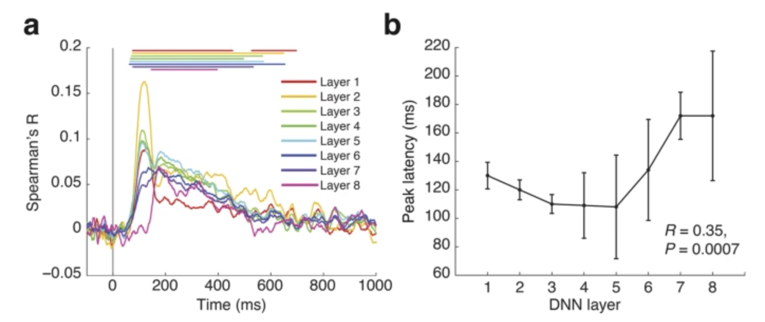
Vision: work utilizing DL progress
Stimuli: images of natural objects
Stimulus representation: layers of CNN tuned for object classification
Brain recording: fMRI & MEG, vision
A CNN tuned for object classification captures stages of human visual processing in both space and time
Cichy, Radoslaw Martin, Aditya Khosla, Dimitrios Pantazis, Antonio Torralba, and Aude Oliva. "Comparison of deep neural networks to spatio-temporal cortical dynamics of human visual object recognition reveals hierarchical correspondence." Scientific reports 6, no. 1 (2016): 1-13.
Notes:
With RSA
We showed that the DNN captured the stages of human visual processing in both time and space from early visual areas towards the dorsal and ventral streams. Further investigation of crucial DNN parameters revealed that while model architecture was important, training on real-world categorization was necessary to enforce spatio-temporal hierarchical relationships with the brain.
We found that all layers of the object DNN were representationally similar to human brain activity, indicating that the model captures emerging brain visual representations
We next investigated whether the hierarchy of the layered architecture of the object DNN, as characterized by an increasing size and complexity of model RFs feature selectivity, corresponded to the hierarchy of temporal processing in the brain. That is, we examined whether there was a hierarchical relationship between layer number of the object DNN and the peak latency of the correlation time courses between object DNN and MEG RDMs. Subject-average data are plotted in Fig. 3b. While for the first four DNN layers the relationship was weak and negative, for the last four layers the relationship was strongly positive.
Together these analyses established a correspondence in the sequence of processing steps of a DNN trained for object recognition and the time course with which visual representations emerge in the human brain
Spatial maps of visual representations common to brain and object DNN. There was a correspondence between object DNN hierarchy and the hierarchical topography of visual representations in the human brain. Low layers had significant representational similarities confined to the occipital lobe of the brain, i.e. low- and mid-level visual regions. Higher layers had significant representational similarities with more anterior regions in the temporal and parietal lobe, with layers 7 and 8 reaching far into the inferior temporal cortex and inferior parietal cortex

Slide 33
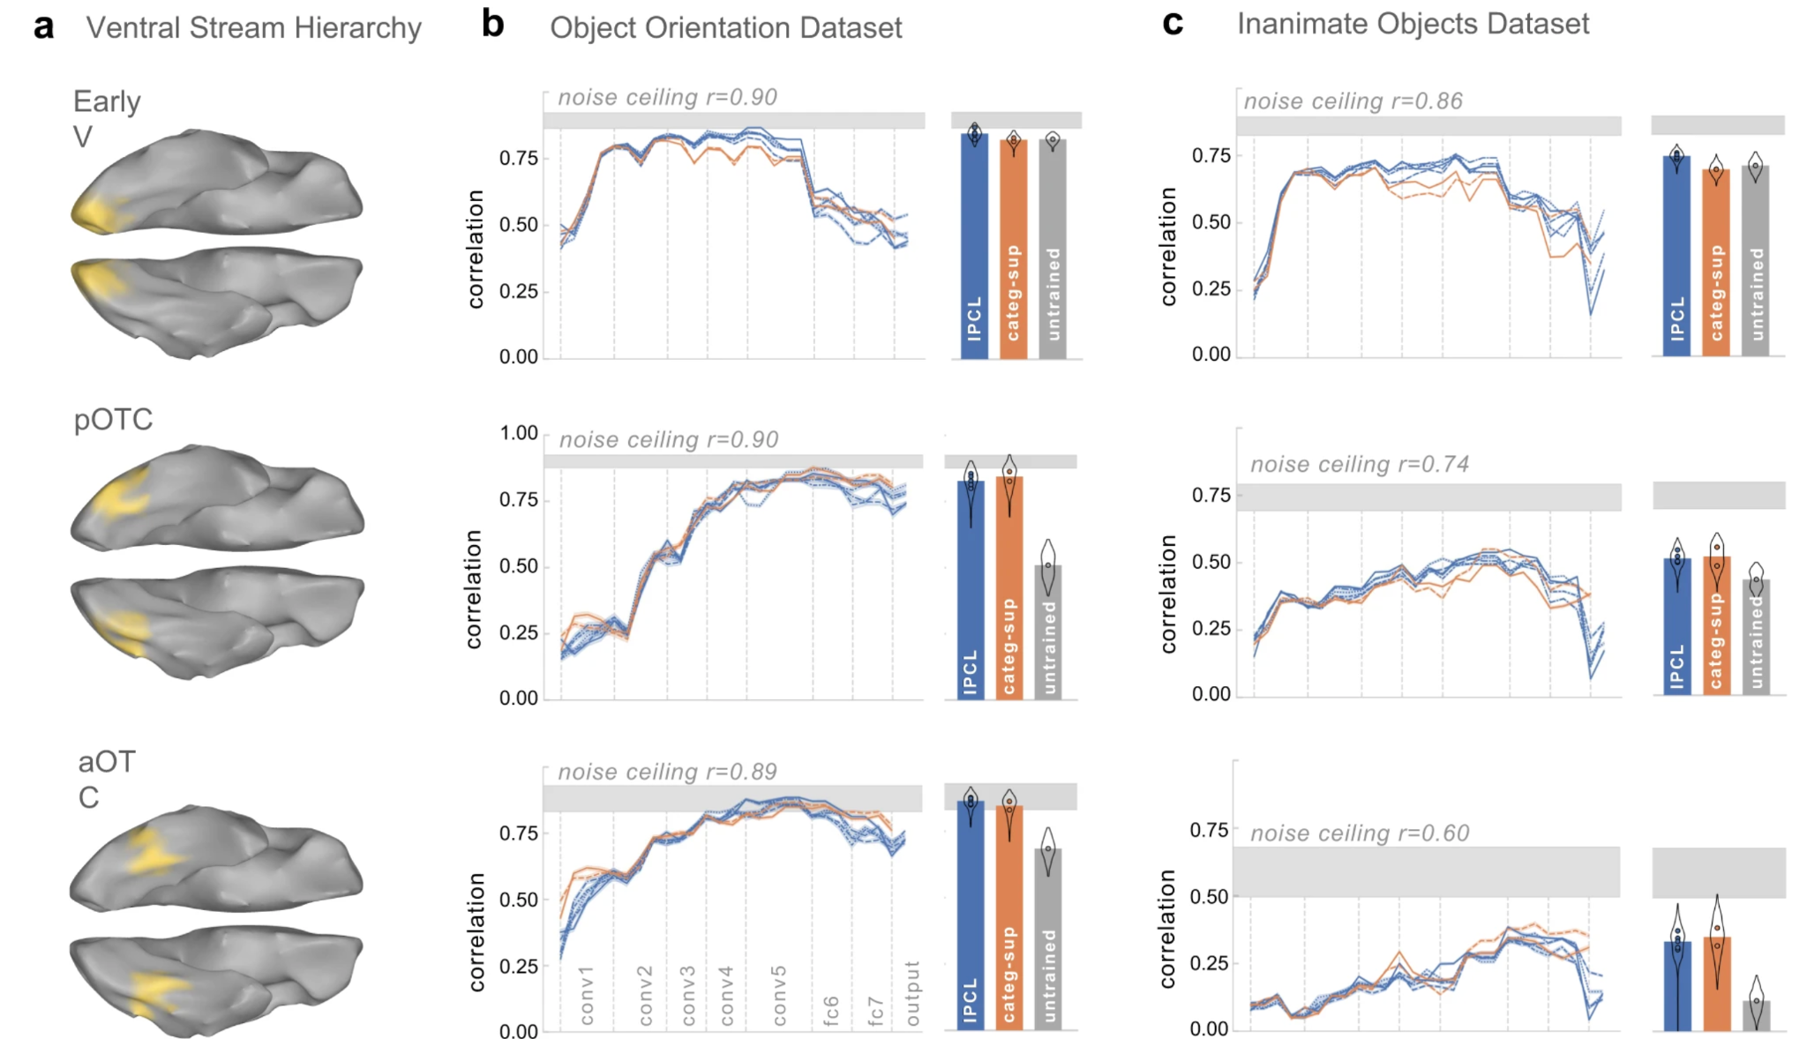
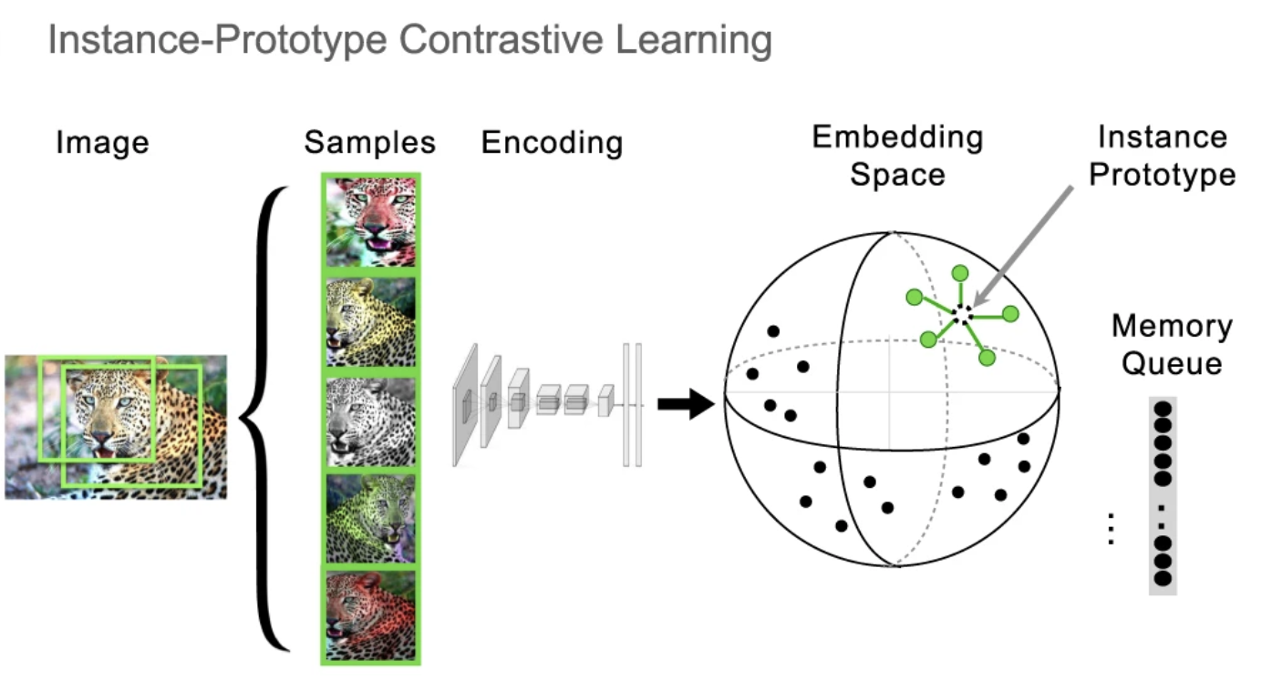
Vision: work utilizing DL progress
Self-supervised deep models achieve parity with category-supervised models in predicting fMRI responses along visual hierarchy
Stimuli: images of objects
Stimulus representation: layers in self-supervised deep model
Brain recording: fMRI, vision
Konkle, Talia, and George A. Alvarez. "A self-supervised domain-general learning framework for human ventral stream representation." Nature communications 13, no. 1 (2022): 1-12.
Notes:
here we developed a learning framework that is fully self-supervised, called instance-prototype contrastive learning (IPCL). The model operates by taking multiple samples over an image and projecting these through a deep convolutional neural network backbone into a low-dimensional embedding space. To learn instance-level structure, the model tries to map these multiple samples of the views nearby by in the latent space (towards the “instance-prototype”), while also making this embedding distinct from the representations of recently encountered views (“contrastive learning”). As such, the final representational format can be conceived of as a high-fidelity perceptual representation, capable of fine-grained discrimination between views. Within the broader cognitive neuroscience context, this model thus operationalizes a domain-general view of visual representation learning, where no specialized pressures beyond the visual system are required to guide the format of visual representation.
In the present work, we show that our instance-prototype contrastive learning models indeed have naturally emergent category structure in the latent space. Further, these models learn hierarchical visual feature spaces that can capture brain response structure, on par with category-supervised models, at or near the noise ceiling of the data in most regions, in two condition-rich fMRI datasets.
To do so, each image is sampled with 5 augmentations, allowing for crops, rescaling, and color jitter (following the same parameters as in ref. 41). These samples are passed through a deep convolutional neural network backbone and projected into a 128-dimensional embedding space, which is L2-normed so that all image embeddings lie on the unit hypersphere. The contrastive learning objective has two component terms. First, the model tries to make the embeddings of these augmented views similar to each other by moving them towards the average representation among these views—the “instance prototype.” Simultaneously, the model tries to make these representations dissimilar from those of recently encountered items, which are stored in a lightweight memory queue of the most recent 4096 images—the “contrastive” component
Anterior regions of the ventral visual stream encode substantial information about object categories. Are top-down category-level forces critical for arriving at this representation, or can this representation be formed purely through domain-general learning of natural image structure? Here we present a fully self-supervised model which learns to represent individual images, rather than categories, such that views of the same image are embedded nearby in a low-dimensional feature space, distinctly from other recently encountered views. We find that category information implicitly emerges in the local similarity structure of this feature space. Further, these models learn hierarchical features which capture the structure of brain responses across the human ventral visual stream, on par with category-supervised models. These results provide computational support for a domain-general framework guiding the formation of visual representation, where the proximate goal is not explicitly about category information, but is instead to learn unique, compressed descriptions of the visual world.
The results show that the IPCL model achieves parity with the category-supervised models in accounting for the structure of brain responses, evident across both datasets and at all three levels of hierarchy. Each plot shows the layer-wise correlations between the predicted and measured brain representational geometry, with all IPCL models in blue (with multiple lines reflecting replicates of the same model with slight training variations, see Methods), and category-supervised models in orange.

Slide 34
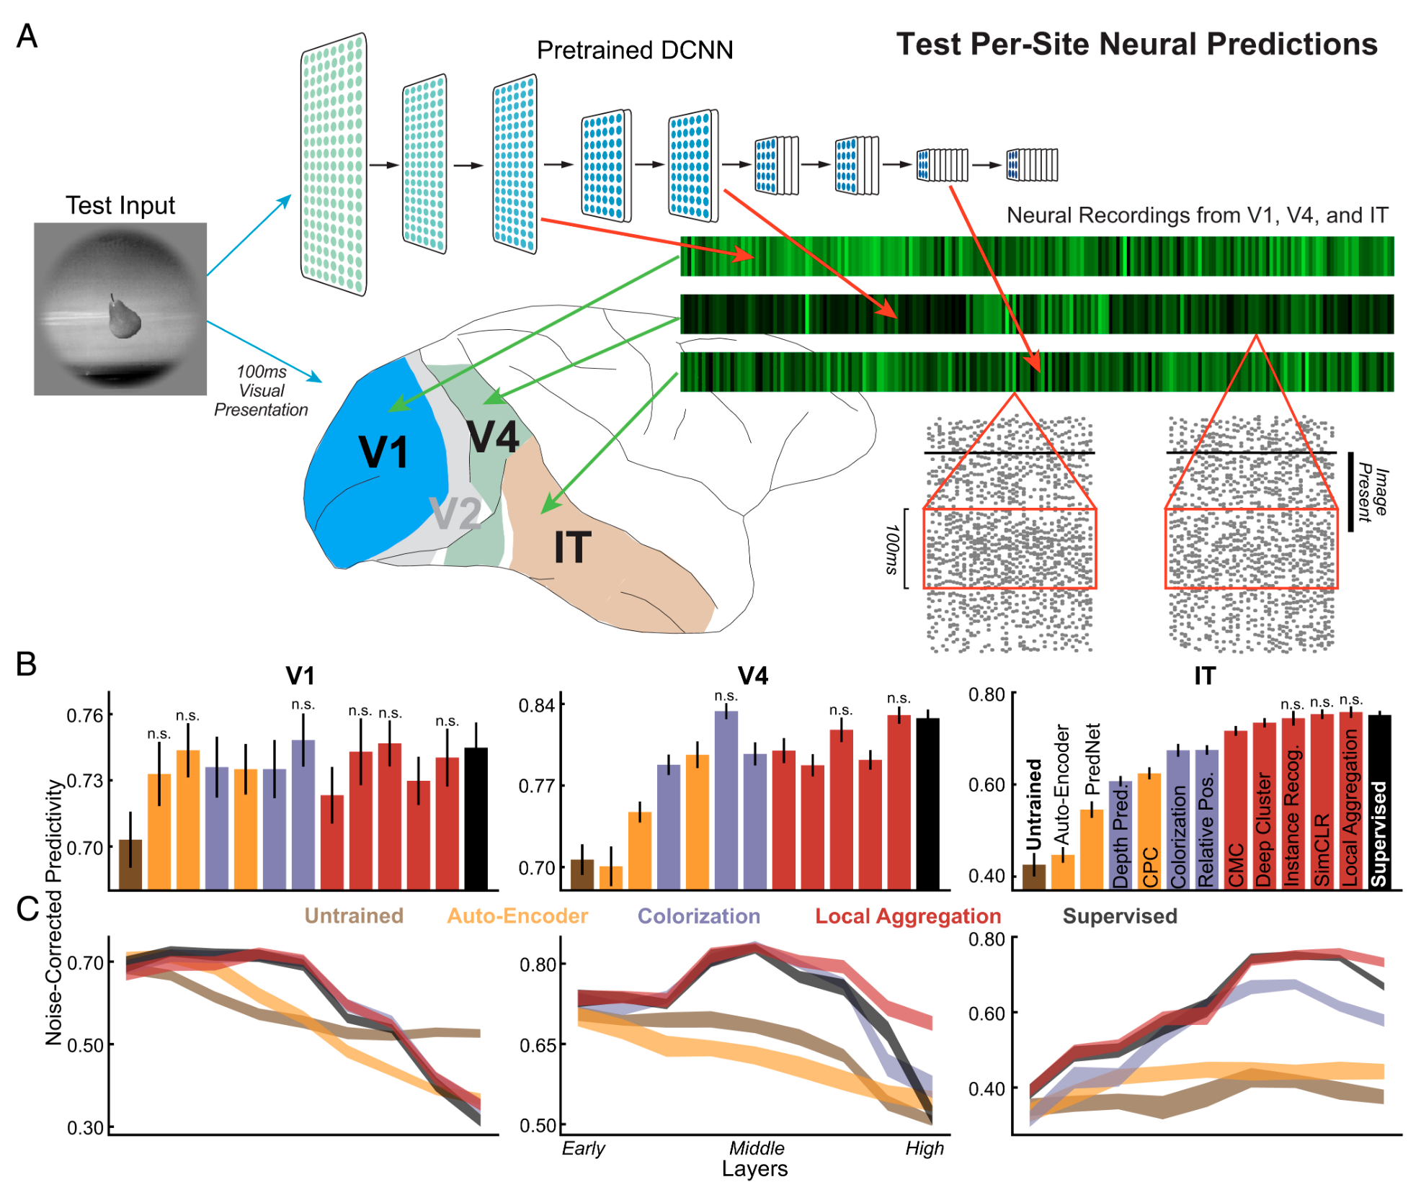
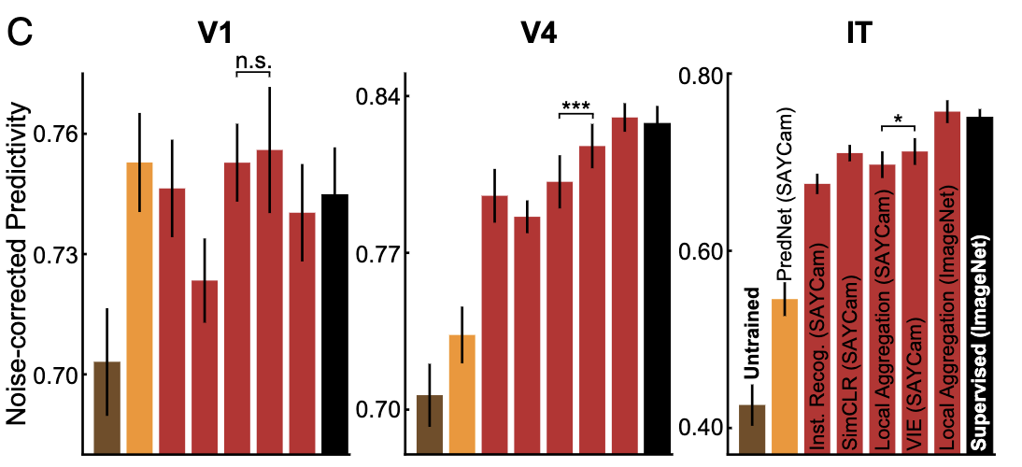
Vision: work utilizing DL progress
Self-supervised deep models produce brain-like representations even when trained solely with noisy data from child head-mounted cameras
Stimuli: images of objects
Stimulus representation: layers in self-supervised deep model
Brain recording: multiarray recordings in rhesus macaques, vision
Zhuang, Chengxu, Siming Yan, Aran Nayebi, Martin Schrimpf, Michael C. Frank, James J. DiCarlo, and Daniel LK Yamins. "Unsupervised neural network models of the ventral visual stream." Proceedings of the National Academy of Sciences 118, no. 3 (2021): e2014196118.
Notes:
We find that neural network models learned with deep unsuper-vised contrastive embedding methods achieve neural predictionaccuracy in multiple ventral visual cortical areas that equals orexceeds that of models derived using today’s best supervisedmethods and that the mapping of these neural network models’hidden layers is neuroanatomically consistent across the ventralstream.
Strikingly, we find that these methods produce brain-like representations even when trained solely with real humanchild developmental data collected from head-mounted cameras,despite the fact that these datasets are noisy and limited.
Taken together, these results illustrate a use ofunsupervised learning to provide a quantitative model of a mul-tiarea cortical brain system and present a strong candidate fora biologically plausible computational theory of primate sensorylearning.
Overall, the unsupervised methods that had higher task trans-fer performance predicted neural responses substantially bet-ter than less-performant unsupervised methods. In the firstcortical visual area V1, all unsupervised methods were signif-icantly better than the untrained baseline at predicting neu-ral responses, although none were statistically better from thecategory-supervised model on this metric. In contrast, in inter-mediate cortical area V4, only a subset of methods achieved par-ity with the supervised model in predictions of responses. (Inter-estingly, the deep autoencoder was not better than the untrainedmodel on this metric and both were widely separated from theother trained models.) For IT cortex at the top of the ven-tral pathway, only the best-performing contrastive embeddingmethods achieved neural prediction parity with supervised mod-els. Among these methods, the local aggregation model, whichhas recently been shown to achieve state-of-the-art unsupervisedvisual recognition transfer performance (41), also achieved thebest neural predictivity. In fact, LA exhibits comparable V1,V4, and IT predictivity to its supervised counterpart (P= 0.10,0.11, and 0.36 correspondingly, computed using bootstrappingmethods which repeatedly sampled neurons with replacementfor 10,000 times; seeSI Appendix, Fig. S4 for details and othersignificance results). Similarly, good neural predictivity is alsoachieved by two other contrastive embedding methods, instancerecognition and SimCLR. More specifically, IR shows compara-ble V1, V4, and IT predictivity to the supervised model (P=0.45, 0.12, and 0.25 correspondingly), although LA surpasses iton both V4 (P= 0.013) and IT (P= 0.021) predictivity, whichis consistent with the difference of these two methods in thetransfer task performance.
After training the two stream models on SAYCam, wefound that representations learned by VIE are highly robust,approaching the neural predictivity of those trained on ImageNet(Fig. 3C). The temporally aware VIE-trained representation wassignificantly (although modestly) better than a purely static net-work trained with LA on SAYCam frames, while both werevery substantially better than PredNet, a recent biologicallyinspired implementation of predictive coding (34). These resultsshow that deep spatiotemporal contrastive learning can takeadvantage of noisy and limited natural datastreams to achieveprimate-level representation learning.

Slide 35
Recent work utilizing progress in DL for encoding
Using representations of stimuli from deep learning systems
Data-driven
Language:
Wehbe et al. 2014; Jain and Huth, 2018; Toneva and Wehbe, 2019; Caucheteux and King, 2020/2022; Schrimpf et al. 2020/2021; Goldstein et al. 2021/2022
Vision:
Yamins et al. 2014; Cichy et al. 2016; Konkle and Alvarez, 2020/2022; Zhuang et al. 2022
Audio:
Kell et al. 2018; Vaidya, Jain, and Huth 2022; Millet et al. 2022

Slide 36
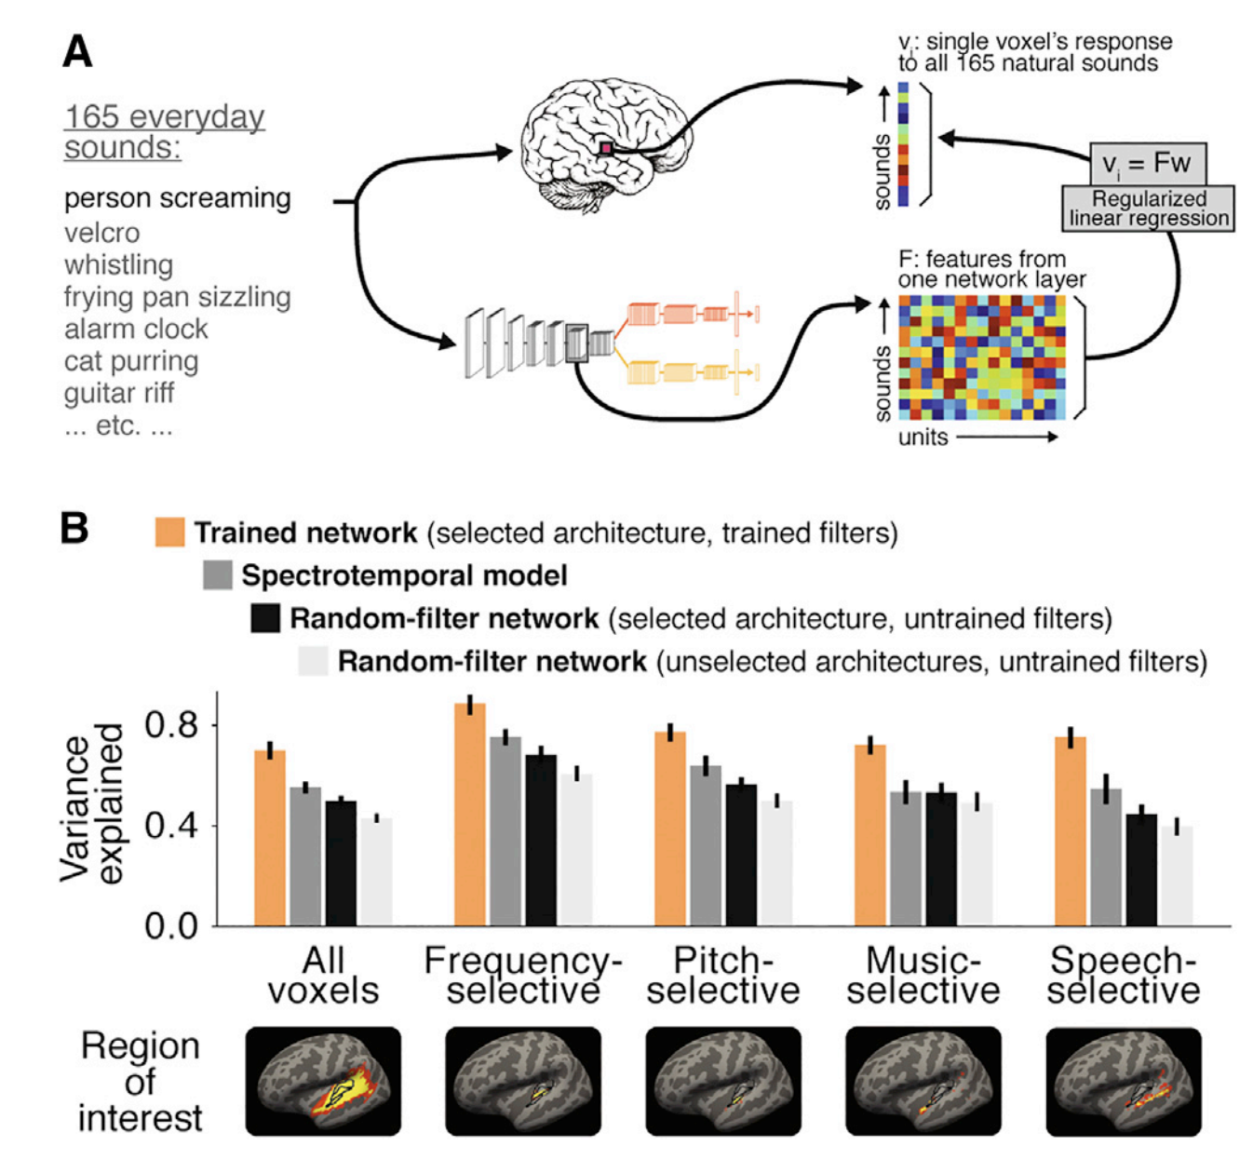
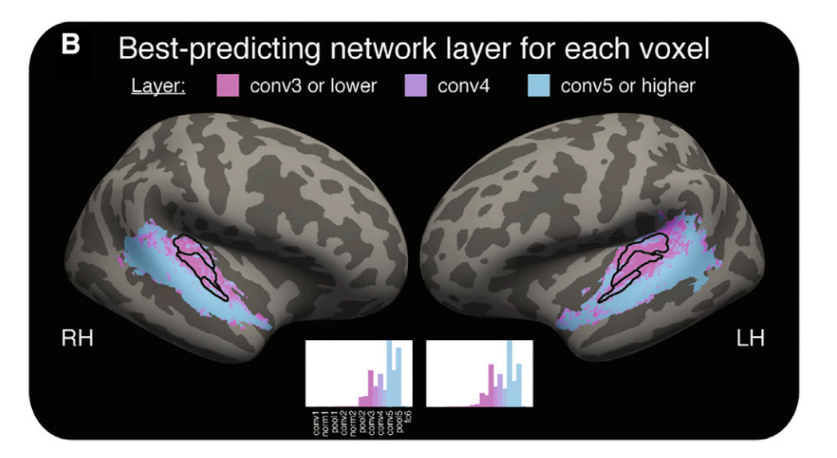
Audio: work utilizing DL progress
Stimuli: natural sounds
Stimulus representation: deep model optimized for speech and music recognition
Brain recording & modality: fMRI, listening
Primary auditory responses predicted best by intermediate layers of task-optimized model;
non-primary responses predicted best by late layers
Kell, Alexander JE, Daniel LK Yamins, Erica N. Shook, Sam V. Norman-Haignere, and Josh H. McDermott. "A task-optimized neural network replicates human auditory behavior, predicts brain responses, and reveals a cortical processing hierarchy." Neuron 98, no. 3 (2018): 630-644.
Notes:
The best-performing network contained separate music and speech pathways following early shared processing, potentially replicating human cortical organization
The network predicted fMRI voxel responses substantially better than traditional spectrotemporal filter models throughout auditory cortex. It also provided a quantitative signature of cortical representational hierarchy—primary and non-primary responses were best predicted by intermediate and late network layers, respectively. The results suggest that task optimization provides a powerful set of tools for modeling sensory systems.
we used two tasks that were behaviorally relevant and for which we could obtain large sets of labeled data: word recognition and musical genre identification
The network model’s predictions were better than the standard spectrotemporal filter model and the random filter network in each ROI
To examine the relationship between the network stages and potential stages of auditory cortex, we determined the best-predicting layer for each reliably sound-responsive voxel in auditory cortex. As shown in Figure 4B, intermediate layers best predicted the voxels in what is classically considered primary (“core”) auditory cortex (denoted by the black outlines). Beyond the core, in either anterior, lateral, or posterior directions, the deeper layers provided the best predictions. The results are consistent with the idea that primary and non-primary cortex are situated at distinct hierarchical stages of processing.

Slide 37
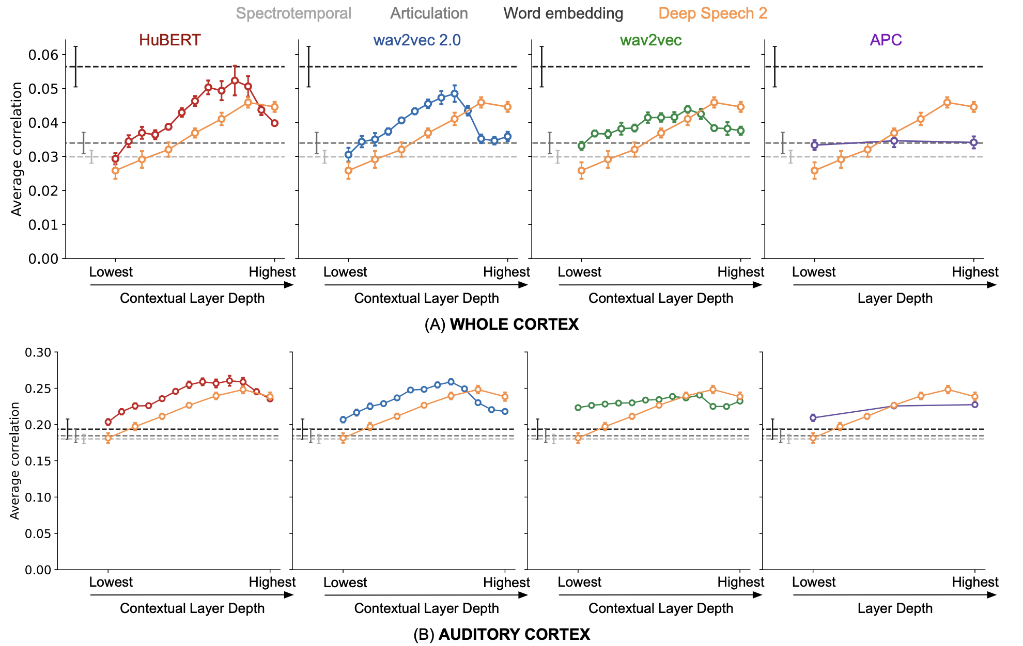
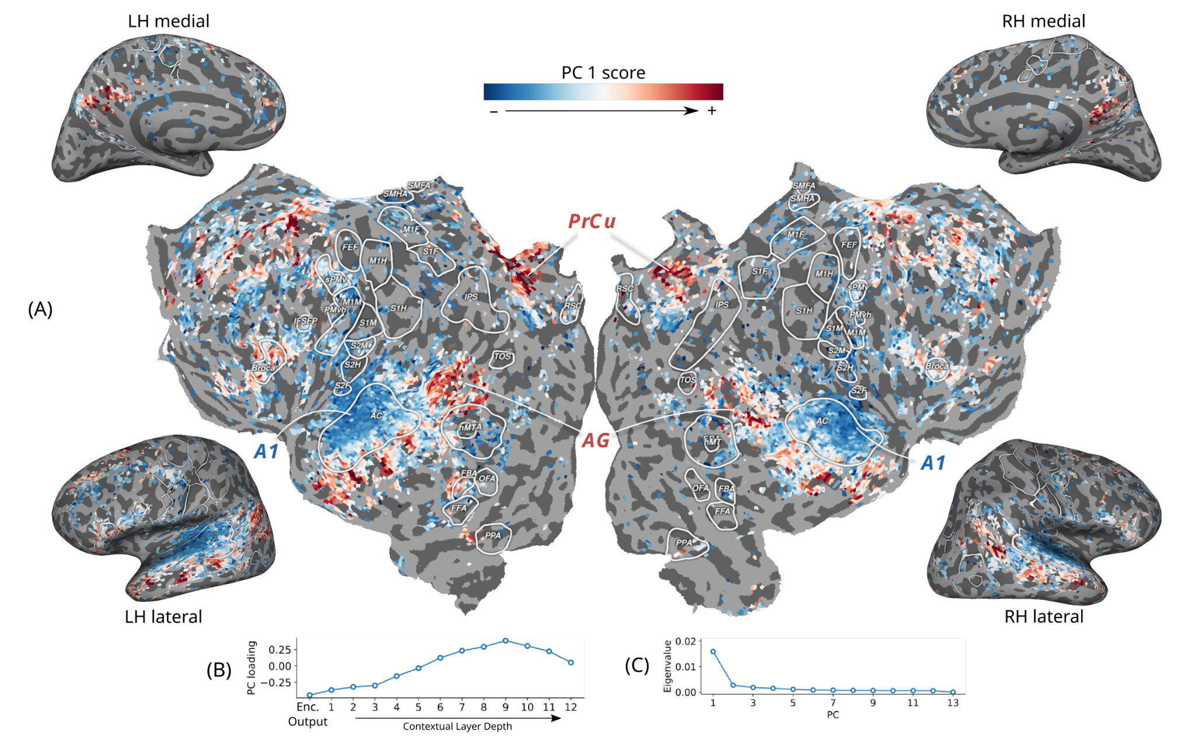
Audio: work utilizing DL progress
Stimuli: Moth Radio Hour
Stimulus representation: derived from pretrained self-supervised speech models
Brain recording & modality: fMRI, listening
Middle layers of self-supervised speech models predict auditory cortex the best
Vaidya, Aditya R., Shailee Jain, and Alexander G. Huth. "Self-supervised models of audio effectively explain human cortical responses to speech." ICML (2022).
Notes:
Brain areas involved in low-level auditory processing exhibit a preference for earlier SSL model layers, whereas higher-level semantic areas prefer later layers.
We show that these trends are due to the models’ ability to encode information at multiple linguistic levels (acoustic, phonetic, and lexical) along their representation depth. Overall, these results show that self-supervised models effectively capture the hierarchy of information relevant to different stages of speech processing in human cortex.
Inspecting the first PC loadings shows that it separates voxels with high performance in the upper-middle layers from voxels with high performance in the lower layers (Figure 3B). We visualized layer selectivity across the cortical surface of one subject by projecting C onto its first PC (Figure 3A).
Overall, layer selectivity roughly follows the hierarchy of speech processing across cortex (Hickok & Poeppel, 2007; Binder et al., 2009). While low-level regions like primary auditory cortex (A1) preferred lower HuBERT layers (negative PC 1 score), high-level regions like the angular gyrus (AG) and precuneus (PrCu) preferred the upper-middle layers (positive PC 1 score).

Slide 38
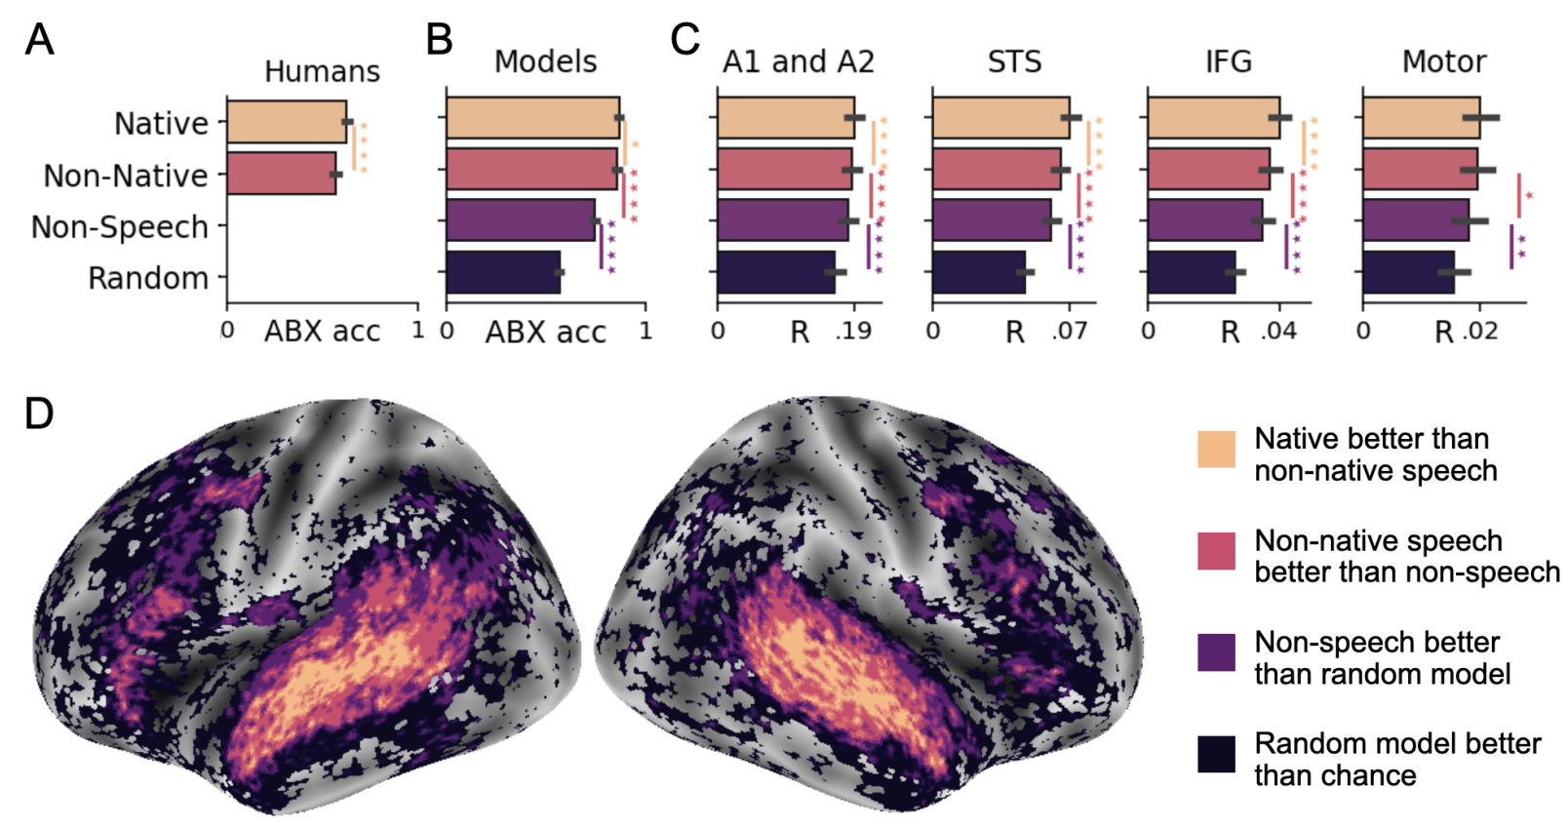
Audio: work utilizing DL progress
Stimuli: audio books
Stimulus representation: derived from pretrained self-supervised speech model
Brain recording & modality: fMRI, listening in 3 languages (Eng, Fr, Mandarin)
Self-supervised speech models exhibit specialization for native sounds in the STS and MTG;
IFG and AG show more general specialization for speech rather than native-language
Millet, Juliette, Charlotte Caucheteux, Pierre Orhan, Yves Boubenec, Alexandre Gramfort, Ewan Dunbar, Christophe Pallier, and Jean-Remi King. "Toward a realistic model of speech processing in the brain with self-supervised learning." arXiv preprint arXiv:2206.01685 (2022).
Notes:
Does the model show commonalities merely with general auditory processing in the brain, or does it capture speech-specific processing? If so, does it show commonalities with brain representations that are specific to the native language of the participants, or merely to general speech processing? We first evaluate the specialization of humans’ perception to their native language using an ABX behavioral task (Section 2.4). Specifically, we compare 386 French and English participants on their ability to distinguish native and non-native phones. As expected Bohn [2017], Kuhl et al. [2005], participants were better at discriminating native sounds than non-native ones (across phone pairs: p < 10−18, Figure 4-A). Second, applying the same test to our self-supervised French and English models shows that, like humans, models best discriminate sounds from their ‘native’ language (i.e., the French model better distinguishes French stimuli than English ones, across phone pairs, and vice versa: p < 0.05). Finally, the random and acoustic models obtain the worst ABX accuracy. These results confirm that 600 h of self-supervised learning suffices for Wav2Vec 2.0 to learn language-specific representations (Figure 4-B).
Wav2Vec 2.0 and the brain learn language specific representations. Next, we compare the Neural Predictivity scores of random, non-speech, non-native and native models (Figure 4-C D). First, our results show that the non-speech model attains higher R scores than the random model (on average across voxels, ∆R = 0.006, p=10−31) confirming the importance of learning to generate brain-like representations. Second, non-native models attain higher R scores than the non-speech model (∆R = 0.002, p = 10−9 ), confirming that Wav2Vec 2.0 learns speech-specific representations of sounds when trained on speech. Finally, the native model attains higher R scores than non-native models (∆R = 0.002, p = 10−15). The specialization for native sounds shared between models and the brain appears to be mainly localized around the superior temporal sulcus and the middle temporal gyrus (Figure 4-D), whereas higher-level regions like IFG and the angular gyrus only show more general specializations (i.e., speech rather than native-language sounds).

Slide 39
Agenda
Introduction to Brain encoding and decoding [30 min]
Stimulus Representations (Theory + Hands-on) [1 hour 30 min]
Coffee break [15 min]
Deep Learning for Brain Encoding (Theory + Hands-on) [1 hour 30 min]
Classic findings & common approaches
More recent findings utilizing deep learning
Hands-on with multi-modal fMRI data [40 min]
Lunch break [1 hour 15 min]
Deep Learning for Brain Decoding (Theory + Hands-on) [1 hour 30 min]
Coffee break [15 min]
Advanced Methods [1 hour]
Summary and Future Trends [15 min]

